Slide 1

Adobe Premiere: Intro

Slide 2


Adobe Premiere is powerful video editing software. The free video editing tools iMovie (Mac) or Movie Maker (PC) might be an easier option for your project, since it has many built in titles, music tracks, etc.
Since Adobe Premiere is more professional, it is expecting you to import your own titles, music, etc into the project.

Slide 3
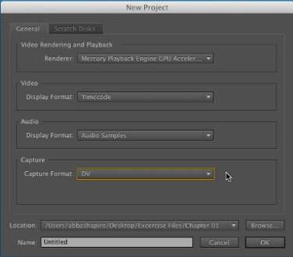
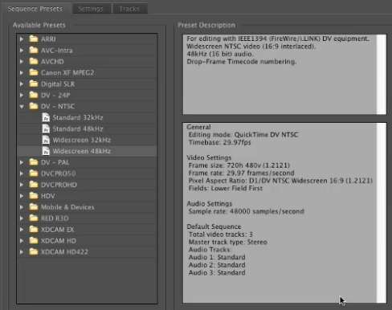


Getting Started:
Pay attention to where you are saving your project.
When opening up a new project, keep the General settings the same.
Cancel out of Setting Presets

Slide 4




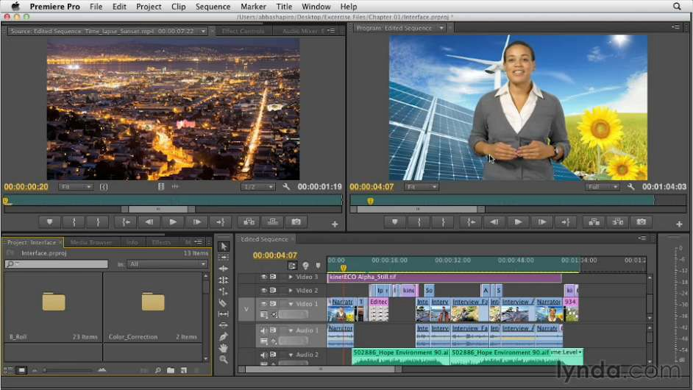










Program Monitor: this is what the viewer will see
Source Monitor
Audio Levels
Project Pane:
copies of your media and timeline
Timeline/Sequence: graphical view of program from beginning to end.
Editing Tools

Slide 5
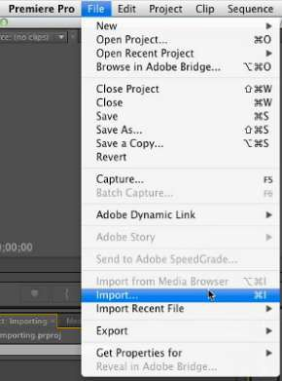
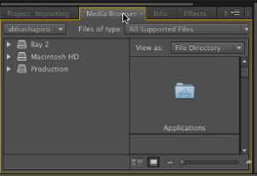
Importing Files:
Or you can double click on the Project Pane and a search box will automatically appear.
Or you can go to the Media Browser tab

Slide 6
Importing Files:
You can import whole folders of still and moving images.
When you import files you are directing the program to where the files live, not actually importing the files into Premiere. This means keeping your original files in the same place is important. This also means that it is harder to harm your original files.
If you organize your files before hand into separate folders (interviews, files to edit, etc) then you can upload your files within these folders and keep them organized.

Slide 7
Editing:
There are many Keyboard Shortcuts that can be used in Adobe Premiere.
Please follow this link to see some of the most common shortcuts that will make your editing more efficient.

Slide 8
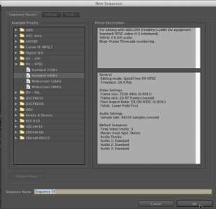
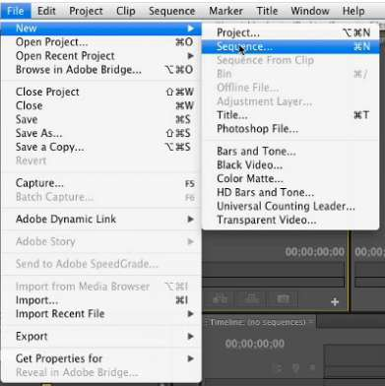
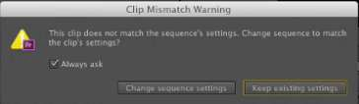
Editing:
Click Ok to the sequence settings – you can edit the settings later if need be.
Creating a sequence to start editing – the sequence is the same as the timeline.
Premiere will correct the settings when you drag in a video clip.

Slide 9
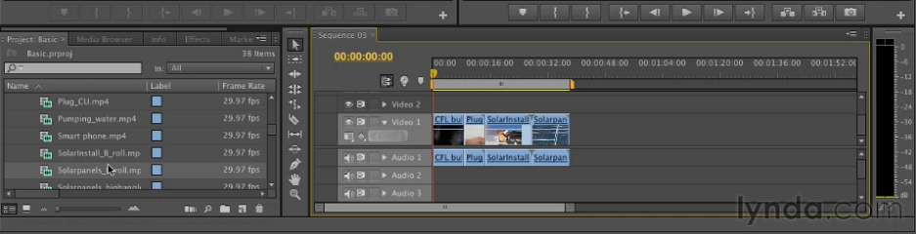


Editing:
Drag and drop your video files into the timeline in whatever sequence you desire to start editing.

Slide 10
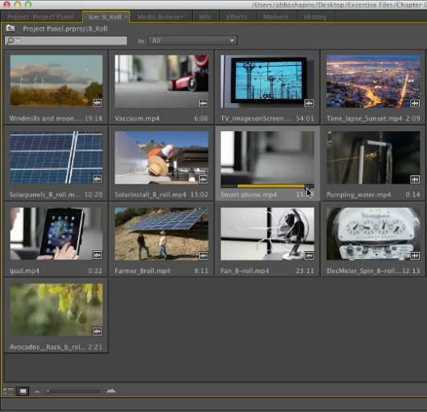








Editing:
You can mark your In and Out points from the Project Panel by making the view “Icons” in the bottom left hand of the screen and then selecting the points by pressing “i” and “o”.

Slide 11
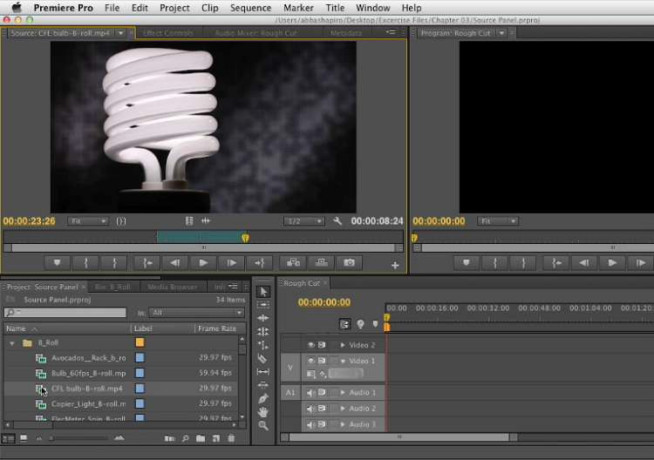




Editing:
Double clicking on clip in Project Panel brings the clip to Source Panel, where you can also edit.
You can also mark In and Out points in the Source Panel.

Slide 12
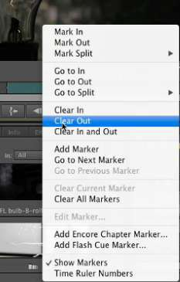
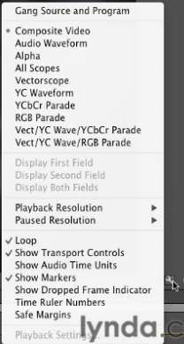




Editing:
By clicking the small wrench on the bottom right of the source panel, you get your Source Panel preference options.
If you Right Click on the Timeline in the Source Panel, you also get these options for editing.

Slide 13
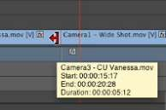


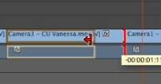






Editing: Trimming
Put your cursor at the beginning or end of where you want to trim.
When it becomes red, you can drag the clip to the desired trimmed spot.
You can drag your clip over into the gap. Make sure they “snap” together. If it does not snap
together, press “s” key.

Slide 14


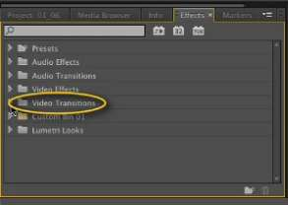
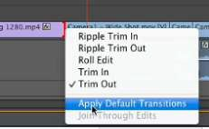
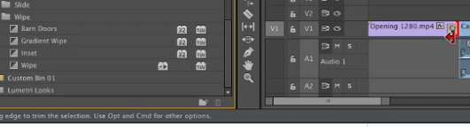
Editing: Transitions
Right click on where you want to add transitions – Select Apply Default Transitions.
If you want something other than Default Transition, you can go to the Effects tab in your Project box and then Video Transitions.
Once you select your transition, you can drag and drop it into desired location on the timeline.

Slide 15
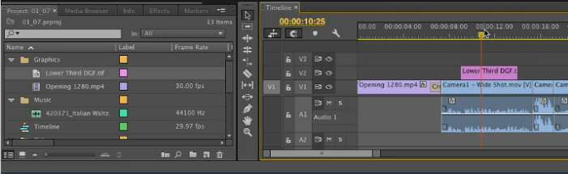


Editing: Titles
You can upload your titles through your own personalized images, such as files made in Photoshop, PowerPoint, or Keynote. One tip is that you can make titles in Photoshop with transparent backgrounds that you can put over footage. Premiere does not come with default titles – you will always need to make your own.
Once you have the image prepared, all you have to do is drag it
into a layer on your timeline.

Slide 16
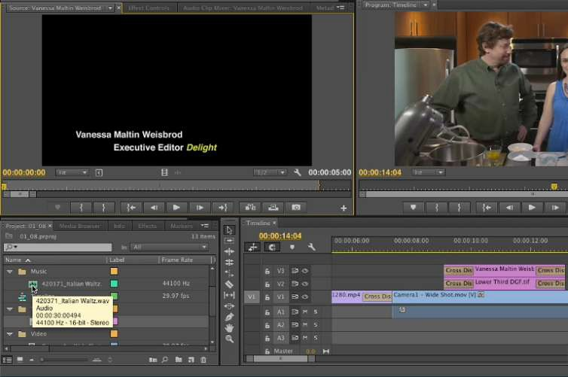




Editing: Music
You can drag your music from the Project folders to the Source Pane or the timeline to begin.
The Source Pane will allow you to edit the music within Premiere.

Slide 17
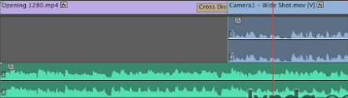
Editing: Music
To view your waves in the timeline, take your cursor to the top of your audio file and drag it down – the blue is the waves of the video file and the green is the waves of an added music track. The two waves represent the left and right channel of the audio.

Slide 18
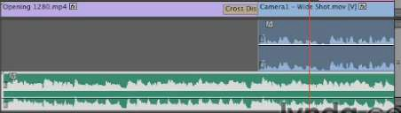


Editing: Music
To adjust the volume, hover your mouse in the middle of the channels and then bring the waves up or down. This way you can make voices louder, and music softer.

Slide 19



Editing: Music
If you drag the Audio option on the left on the timeline out, the middle circle button is where you can add and remove Keyframe.
A keyframe allows you to split the audio in order to change volumes at different spots on your music or voice tracks.

Slide 20
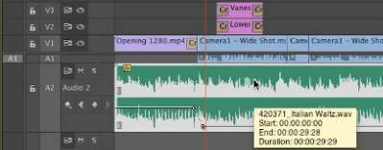
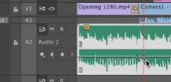








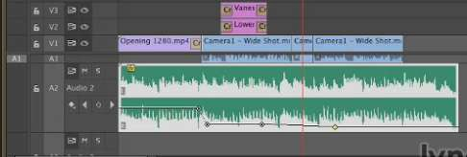
Editing: Music
Make sure your audio is selected and you make at least two keyframes. This way you can keep one at high volume and then bring your volume down at the split (see above). You can add more for subtly fading in or out if desired.

Slide 21
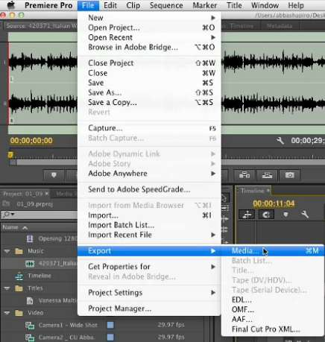
Exporting Project
Make sure timeline is selected and go to File – Export – Media.

Slide 22
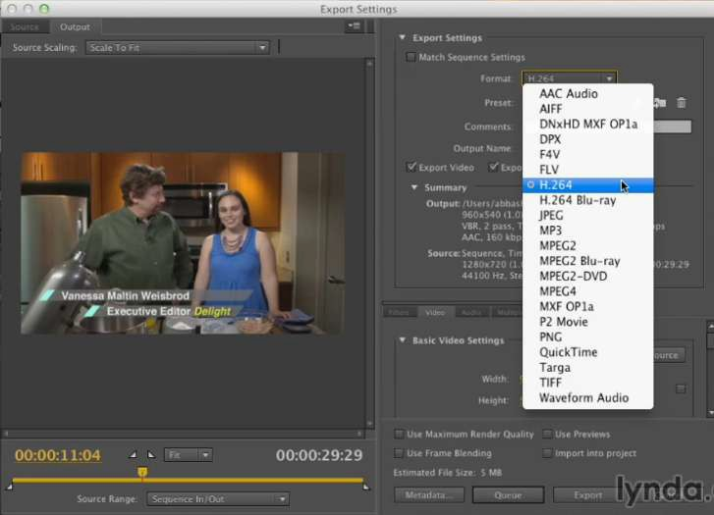


Exporting Project
You will get this dialogue box. To select which format you want to export, to to the format tab. See image to left for all the options.

Slide 23
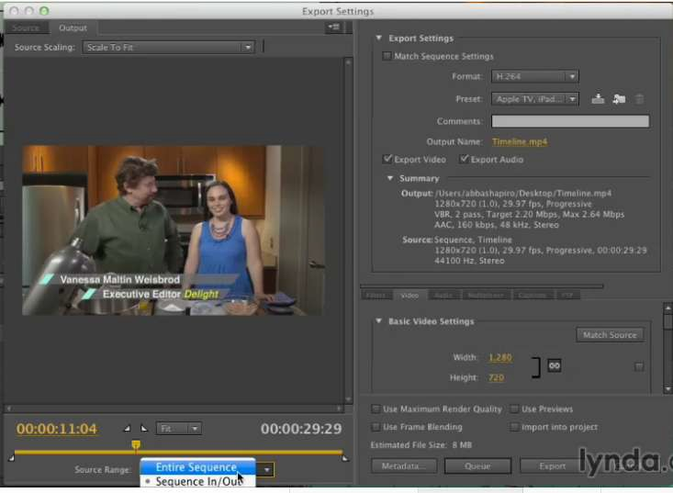




Exporting Project
Be sure to select the “Entire
Sequence” getting exported on the bottom left.

Slide 24
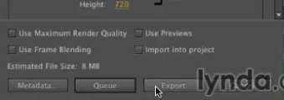


Exporting Project
When all of your settings are done, push the export key. Be sure to allow for plenty of time to export since you are combining many types of high quality media.
***Allow for at least as long as your video – most likely you will need longer to export than you think.

Slide 25
Sources:
This tutorial was made from Lynda.com tutorial: Premiere Pro CC Essential Training
By Abba Shapiro

