Slide 1
P
CHAPTER 10: SHOT SIZES, MOVES, AND FRAMING

Slide 2
SHOT SIZES, MOVES, AND FRAMING
The TV and Film industry use “SHOTS” when describing their production visuals; knowing the typical types of shot sizes, moves, and framing is essential to effective broadcast production
A SHOT is how much visual information is in the camera frame at one time and how it is composed
A SHOT is one continuous camera segment and can be very short or very long - a SHOT will NEVER have an edit in it; edits are what separate shots.

Slide 3
SIX BASIC SHOT SIZES
WIDE SHOT (WS)
LONG SHOT (LS)
MID/MEDIUM-SHOT (MS)
MEDIUM CLOSE UP (MCU)
CLOSE UP (CU)
EXTREME CLOSE UP (ECU)
– See following slides for examples

Slide 4
SHOT SIZES
  A WIDE SHOT (WS) is often also known as an “establishing shot”
  It should be big enough to show all the action and help the viewer with the geography of where everything in the scene is; most often the people in the shot (if any) are not filling the frame

Slide 5

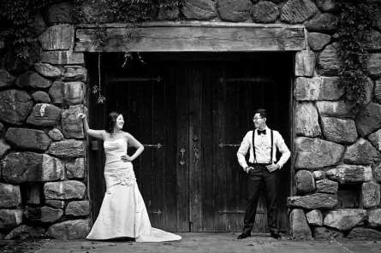
EXAMPLES OF WIDE SHOTS

Slide 6
SHOT SIZES
– A LONG SHOT (LS) tends to be used when talking specifically about people and means you would have the whole body basically filling the frame from top to bottom

Slide 7
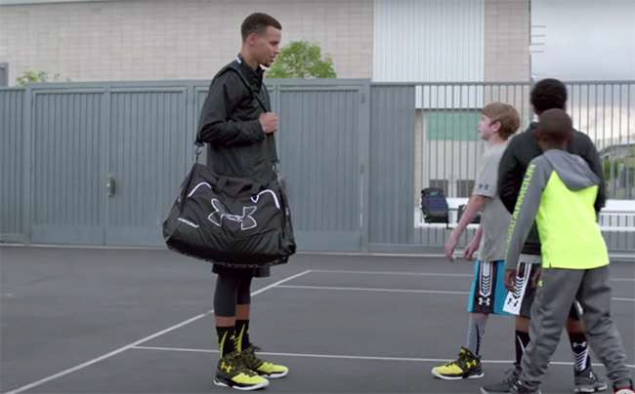
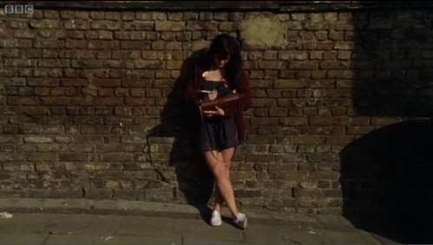
EXAMPLES OF LONG SHOTS

Slide 8
SHOT SIZES
  A MID-SHOT (MS) – also often known as a MEDIUM-SHOT, shows a smaller area than the long shot but still contains quite a bit of information; if there are people in the scene then you would tend to have their head and torso shown, typically down to the waist
  Tip: MEDIUM = HALF (as in half a person)

Slide 9
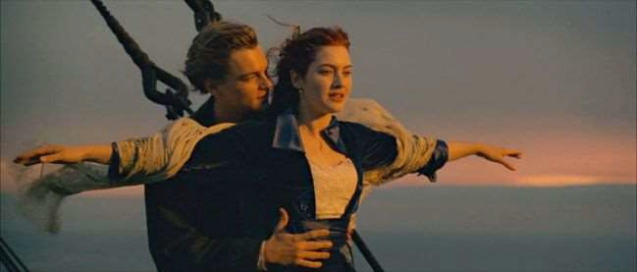

EXAMPLES OF MID/MEDIUM SHOTS

Slide 10
SHOT SIZES
  A MEDIUM CLOSE UP (MCU) – in that area between a MS (Mid/Medium Shot) and a CU (Close-Up)
  If your subject is a person it would tend to be a head and shoulders shot

Slide 11
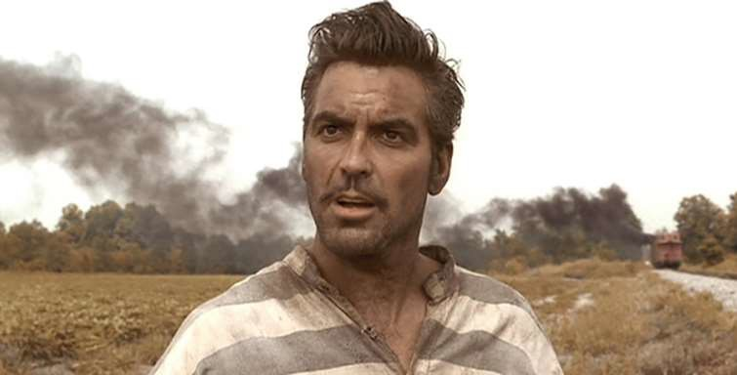
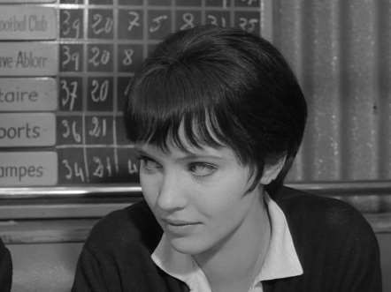
EXAMPLES OF MEDIUM CLOSE- UP SHOTS

Slide 12
SHOT SIZES
  A CLOSE UP (CU) – when the shot is looking in detail at something in the scene
  If your subject is a person it could be just the head or just the hand; if it’s a smaller object then it tends to be where the object fills the screen

Slide 13
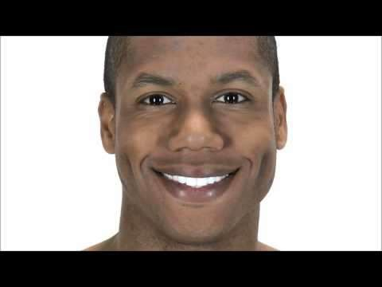
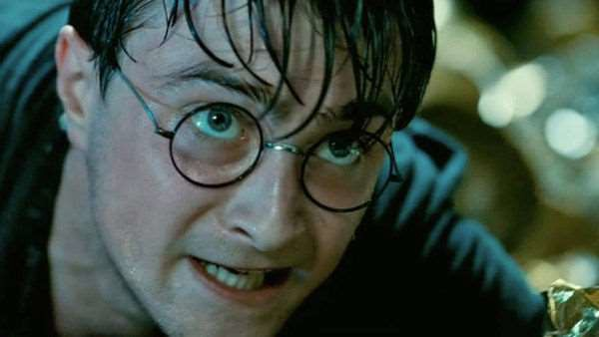
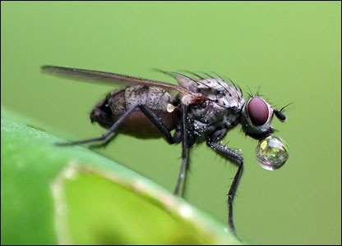
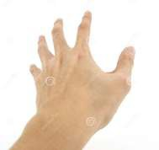

EXAMPLES OF CLOSE-UP SHOTS

Slide 14
SHOT SIZES
– AN EXTREME CLOSE UP (ECU) – when the shot is highlighting a very small detail of something on the screen, to the point where nothing else is really visible

Slide 15
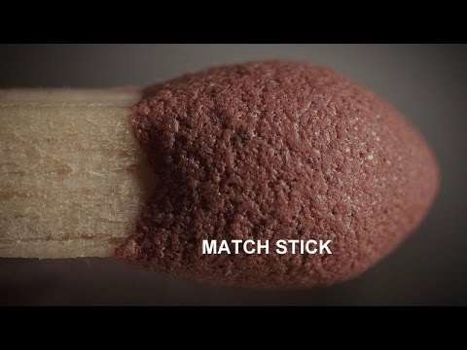
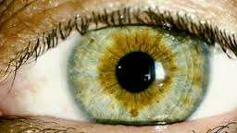
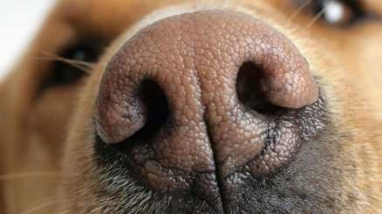
EXAMPLES OF EXTREME CLOSE- UP SHOTS

Slide 16
SHOT SIZES, MOVES, AND FRAMING
Sometimes directors will refer to the shots by the number of people in them.
SINGLE-SHOT = One Person
TWO-SHOT = Two People
THREE-SHOT = Three People
Once you get over three, the numbering
doesn’t really apply – it becomes a “GROUP SHOT”

Slide 17
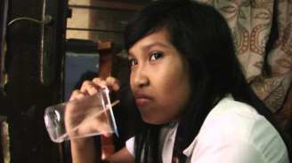
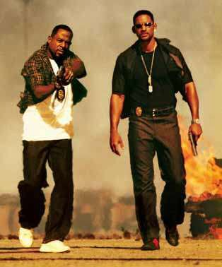
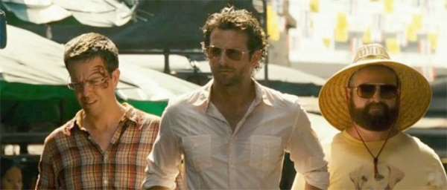
SINGLE, TWO, AND THREE-SHOT EXAMPLES

Slide 18
SHOT SIZES, MOVES, AND FRAMING
Please note that SINGLE, TWO, and THREE- SHOTS also need to be specified as WIDE to CLOSE-UP shots to be clear and effective
The SINGLE, TWO, and THREE modifiers are only there to specify the number of people in them; you also need to know how much of the people to show – see next slide for examples:

Slide 19

SINGLE, TWO, AND THREE-SHOT EXAMPLES
= SINGLE-SHOT as a MEDIUM CLOSE-UP (MCU)
= TWO-SHOT as a LONG SHOT(LS)
= THREE-SHOT as a MID/MEDIUM SHOT (MS)

Slide 20
POINT OF VIEW (POV) SHOT
A Point Of View (POV) Shot is just what it sounds like – it’s the type of shot that makes the viewer think that they are seeing exactly what the character or presenter is seeing and from the same position; a Point Of View shot enables the viewer to see a specific situation or environment as if they were in the shot themselves.
– See the next slide for examples

Slide 21
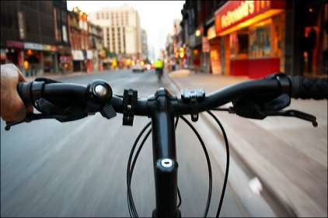
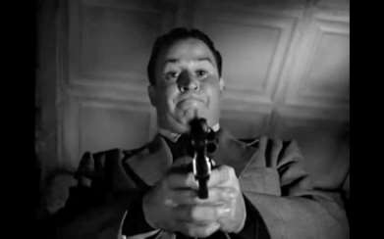
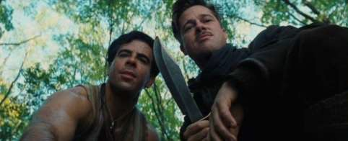
POINT OF VIEW (POV) SHOTS

Slide 22
OVER-THE-SHOULDER (OTS) SHOT
Again, an Over-The-Shoulder (OTS) Shot is just what it sounds like – it’s the type of shot that makes the viewer think that they are there but looking over the shoulder of a character; instead of feeling like she IS the character, it makes a viewer feel she is there and watching as a voyeur but not directly involved.
– See the next slide for examples

Slide 23
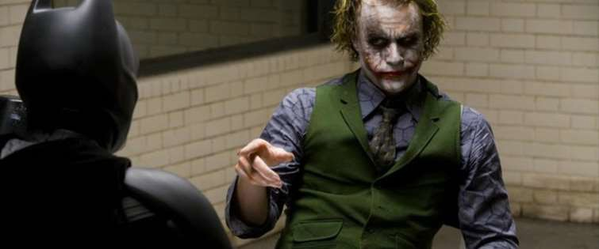
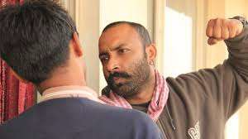
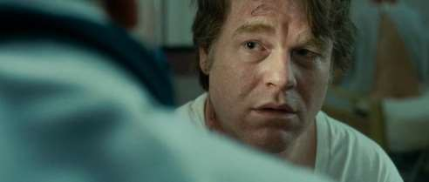
OVER-THE-SHOULDER (OTS) SHOTS

Slide 24
SHOT ANGLES
Shots can also be taken with the camera at different tilts/heights which result in various ANGLES; any of the shots we’ve already discussed can be taken from different angles to get different effects – think of them as HOW the camera is PHYSICALLY TILTED IN THE SHOT. So imagine that YOU are the camera; what way would you have to tilt/where would have to be to see the shot the way it’s presented?

Slide 25
FIVE BASIC SHOT ANGLES
LOW ANGLE
EYE LEVEL ANGLE
HIGH ANGLE
BIRD’S EYE ANGLE
OBLIQUE ANGLE
  See following slides for examples

Slide 26
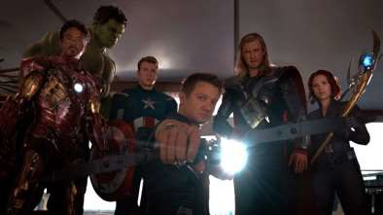
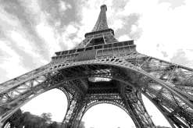
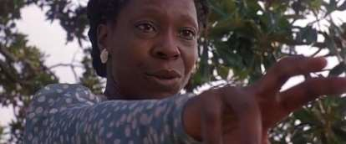
LOW ANGLE EXAMPLES
This type of shot gives the viewer the impression they are looking UP at something – as you can see from these examples the severity of the angle may vary but they are ALL considered LOW angle shots as the camera is tilted UP at the subject(s):

Slide 27
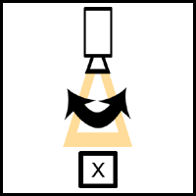
PAN/WHIP PAN MOVEMENT EXAMPLE
A PAN type of movement sees the camera remaining on the same spot but SWIVELS side-to-side as if on a tripod. A “WHIP PAN” is simply a pan done very
^{quickly} CLICK HERE FOR A VIDEO EXAMPLE

Slide 28
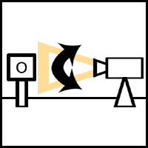
TILT MOVEMENT EXAMPLE
A TILT type of movement sees the camera remaining on the same spot but TILTS up and down as if on a tripod.
CLICK HERE FOR A VIDEO EXAMPLE

Slide 29
ZOOM “MOVEMENT”
A ZOOM is not technically a “MOVE” but it gives that appearance; it’s when the camera pulls in tight or pulls out wide but doesn’t
actually move – it’s all done inside the camera to give the illusion of camera movement
CLICK HERE FOR EXAMPLES OF ZOOMS AS
USED IN “THE SHINING”

Slide 30
ZOOM “MOVEMENT”
Variations of the ZOOM include
  CRASH ZOOM – a zoom done very quickly:
  CLICK HERE FOR EXAMPLES OF THE CRASH ZOOM USED
BY QUENTIN TARANTINO
  DOLLY ZOOM – the combination of a DOLLY shot and a ZOOM to give the viewer the disorienting effect of two different movements happening simultaneously in the same shot
  CLICK HERE FOR MORE ON THE DOLLY ZOOM IN VARIOUS FILMS

Slide 31
TRACKING/DOLLY SHOT EXAMPLE
This is when a camera physically moves through a scene on TRACKS via a DOLLY– it’s how a shot can MOVE through a scene and/or WITH characters.
CLICK HERE FOR MORE ON TRACKING/DOLLY SHOTS WITH GREAT EXAMPLES
The basic effect of a Tracking/Dolly shot can also be achieved by use of a STEADICAM which appears to “fly” through the scene and doesn’t use tracks
CLICK HERE FOR A LOOK AT THE STEADICAM AND FIVE MILESTONE USES OF IT
CLICK HERE FOR EVEN MORE ON THE STEADICAM FROM ITS INVENTOR

Slide 32
DOLLY VS. ZOOM SHOTS
Click here for a great video about the difference between DOLLY and ZOOM shots

Slide 33
SHOT SIZES, MOVES, AND FRAMING
Remember; every shot is comprised of 3 basic decisions:
  SIZE
  ANGLE
  MOVEMENT (even if that movement is “none”, that’s still a decision about movement, right?)
How and why these decisions are made are incredibly important as they determine the effect the visual production will have on the audience

Slide 34


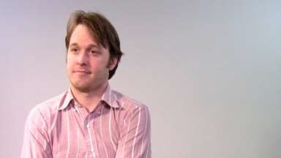
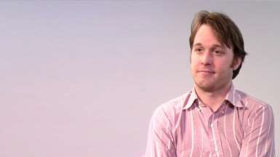
LOOKING ROOM & HEADROOM
When framing a person in a shot, you traditionally make certain you frame it so to give the person
enough LOOKING ROOM and don’t cram them into one side so they look like they’re bumped up against
a wall:

Slide 35
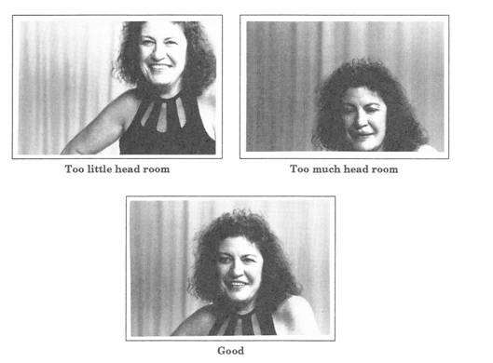
LOOKING ROOM & HEADROOM
Similarly, when framing a person in a shot, you traditionally make certain you frame it so to give the person appropriate HEADROOM so
they’re neither too close to the top of the frame or too close to the bottom

Slide 36
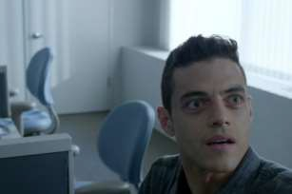
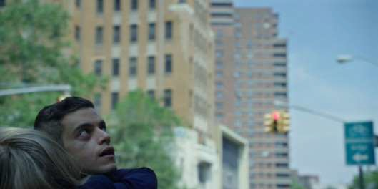
LOOKING ROOM & HEADROOM
Both of these “rules” can be broken for stylistic reasons but typically they are followed for good frame composition in Broadcast Production. MR. ROBOT is a show that loves to break these rules (see below) but they do so for effect and definitely on purpose. Remember, you have to KNOW the rules to BREAK the rules.
CLICK HERE FOR MORE ON MR. ROBOT’S UNIQUE VISUAL STYLE

Slide 37
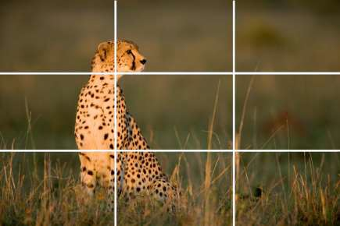
RULE OF THIRDS
The RULE OF THIRDS is a concept of framing that uses imaginary horizontal lines dividing the frame into three and then three imaginary vertical lines doing the same thing

Slide 38
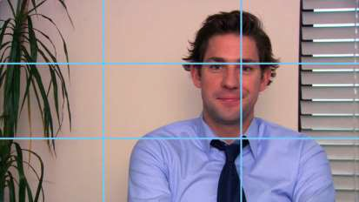


RULE OF THIRDS
This is based on the idea that it’s thought that when you look at a picture the intersection of these lines is the place a viewer’s eye most naturally looks at; putting things of the most interest in one of these spots will make your brain feel comfortable with the frame’s composition

Slide 39
DEPTH OF FIELD
DEPTH OF FIELD refers to how much of the frame contents are in FOCUS; a SHORT/SHALLOW DEPTH OF FIELD has just part of the contents in focus while a LONG/DEEP DEPTH OF FIELD has most, if not all, of the contents in focus.
See examples on the following slides

Slide 40
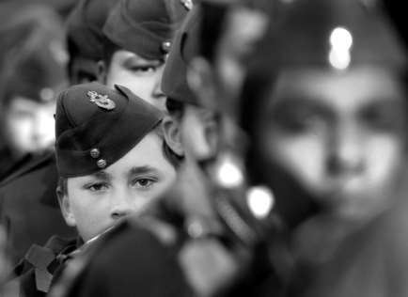
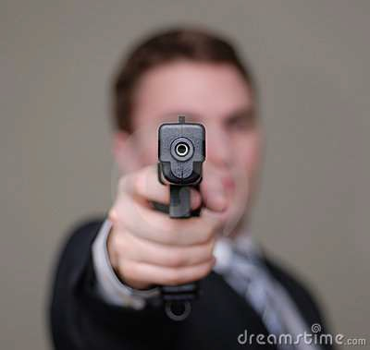
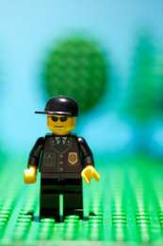
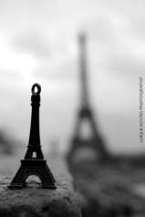
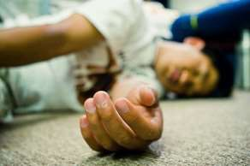
SHORT/SHALLOW DEPTH OF FIELD

Slide 41
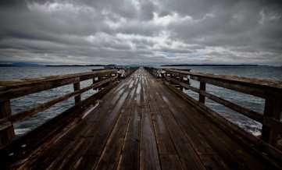
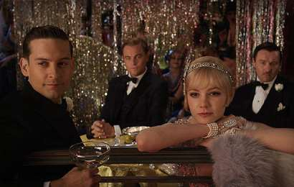
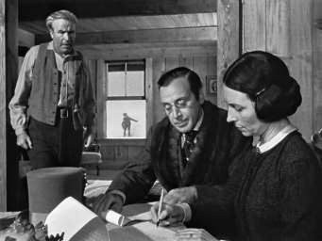
LONG/DEEP DEPTH OF FIELD

