Slide 1
Film Genres

Slide 2
Genre
Categorization of narrative films by the stories they tell and ways they tell them
  Conventions
  Expectations (follow or subvert)
Organized categories of texts
  Exist in academic, popular and industry discourse
Put into categories by:
  Subject matter
  Conventions
  Themes
  Narrative

Slide 3
Uses of Genre
Allows us to predict what sort of movie to expect
Helps audiences to select the movies they attend
Reviewers’ critiques compare one film to others in its genre
Movie rental and retail sales organization
Movie listings

Slide 4
Genre Conventions
Story formulas
Themes (unifying idea)
Character types
Setting
Presentation (formal elements)
Stars

Slide 5
Examples of genre
Science Fiction
Horror
War
Epics/Historical
Action/Adventure
Drama
Comedy
Crime/Gangster
Musicals
Sub genres:
Biopics
Detective/Mystery
Disaster
Fantasy
Film Noir
Melodramas
Sports
Supernatural
Thriller/Suspense

Slide 6
Six Major American Genres
Gangster
Film noir
Science fiction
Horror
Western
Musical

Slide 7
Evolution and Transformation of Genre
The process by which a particular genre is adapted to meet the expectations of a changing society
A hybrid may combine any combination of genres
Subgenres occur when areas of narrative or stylistic specialization arise within a single genre

Slide 8
Generic Transformation
The process by which a particular genre is adapted to meet the expectations of a changing society.
    Primitive - naïve, new, conventions start here
    Classical - balance, richness, poise. Values of genre are mostly shared by audience.
    Revisionist - amibiguous. Conventions are often exploited to undermine popular beliefs.
    Parodic - mockery of conventions, presenting the cliches of the genre for comic effect.
Notes:
Western - Great Train Robbery, Stagecoach (Ford, 1939), High Noon (52) began questioning, same with Wild Bunch. Then on to Blazing Saddles. Though they come back.

Slide 9
Defining Elements of the Genre: Western
A form of modern American mythology
Wilderness versus civilization
Setting: rural, dominated by landscape
Duality of characters
Highly recognizable visual style

Slide 10
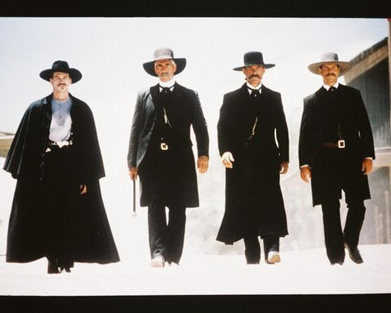
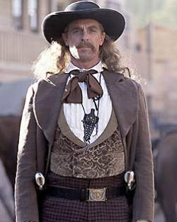
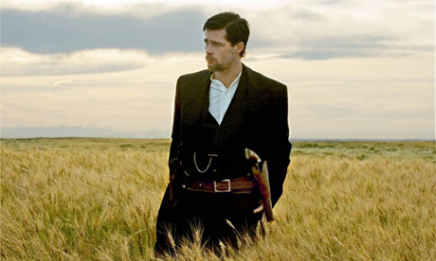
Historical basis
The Western is an American genre, which interprets and represents its history to itself
  Set approximately between 1860 – 1910
  Period of American western expansion
  Popular characters based on actual individuals: Wyatt Earp, Jesse James, Wild Bill Hickok

Slide 11
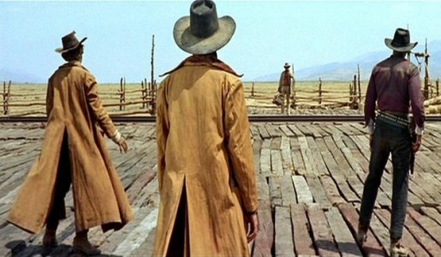
The Western’s Plot elements/themes
Central Theme: The Binary of Civilization and Savagery/Lawlessness
  East vs. West
  Culture vs. Nature
  Community vs. Individual
  Settlers vs. “Indians”
  Train vs. Horse
Westerns as American mythology
  Foundational myth – the forging of a nation

Slide 12
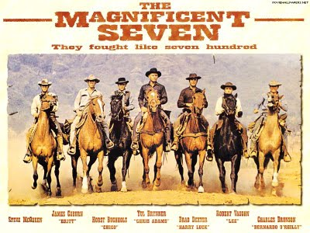
Western plot elements/themes
Patterns of action
  The nomadic Westerner comes to a town, purges it of its savage elements, and leaves
  A group of gunmen are hired to defend villagers from bandits
  Revenge Plots
Narrative Tropes
  The climactic gunfight
  Indian attacks
  The cavalry rescue

Slide 13
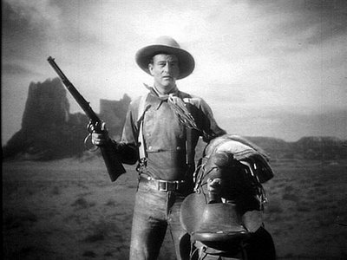
The traditional Western Hero
In-between position: mediates between civilization and the lawless frontier
Marginalized figure outside of the community
Commonly motivated by revenge and/or sense of justice
Adheres to a code
Stagecoach

Slide 14
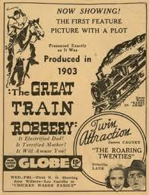
Genre Cycles
Genres are neither static nor fixed; they undergo change over time with each new film either adding to the tradition or modifying it.
Western a popular genre of
B movie fare since 1903
Primitive Phase:
  The Great Train Robbery (1903)

Slide 15
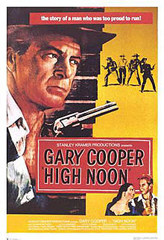
Genre Cycles
Post-war Phase
  High Noon (Frank Zinnemann, 1952)
    Plot takes place in “real time”
    Denies the usual generic pleasures
    Kane as an individual with a code
    Film editing/framing emphasizes
    the isolation of the hero

Slide 16
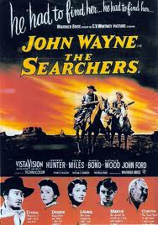
Genre Cycles
Widescreen Westerns
    The Searchers (John Ford, 1956)
      Emphasizes the widescreen landscape
      More complex protagonist (anti-hero)
      The salient techniques of
      style: cinematography

Slide 17
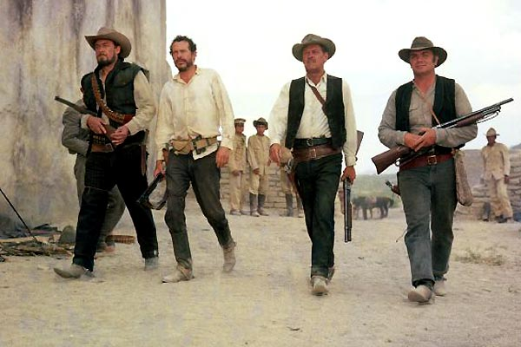
Genre Cycles
The Revisionist Western
  The Wild Bunch (Sam Peckinpah, 1969)

Slide 18
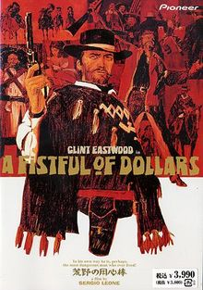
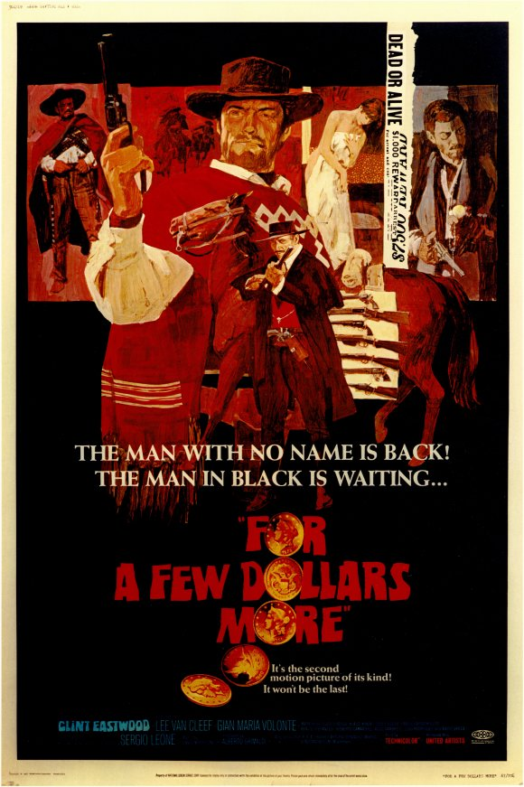
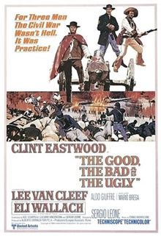
Genre Cycles
‘Spaghetti’ Westerns
  A Fistful of Dollars (Sergio Leone, 1964)
  For A Few Dollars More (Leone, 1965)
  The Good, the Bad, and the Ugly (Leone, 1966)

Slide 19
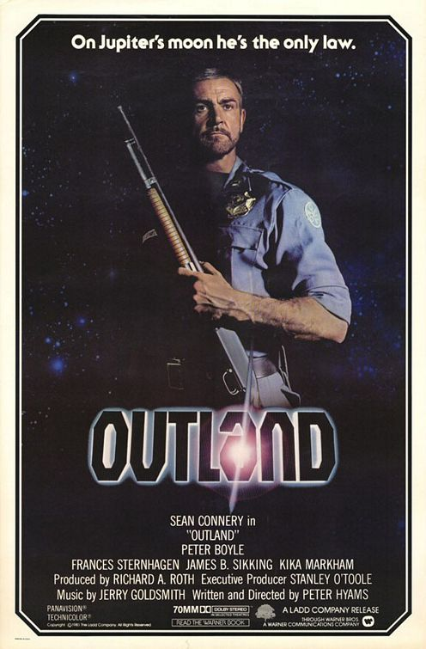
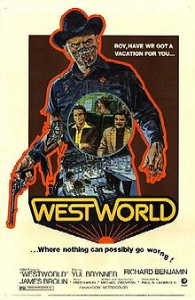
Genre mixing: Science Fiction & the Western
Star Wars (George Lucas, 1977)
  Influenced by the films of John Ford and Akira Kurosawa: The Searchers & The Hidden Fortress
Westworld (Michael Crichton, 1973)
Outland (Peter Hyams, 1981)
  Based on High Noon
Star Trek (1966-1969)
  “Wagon train to the stars”
Firefly (Whedon, 2002)

Slide 20
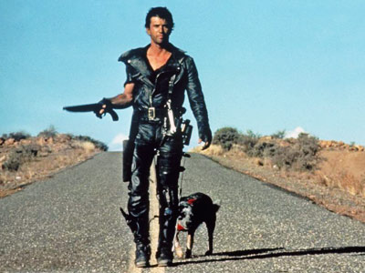
Genre mixing
Post-apocalyptic Western
  Mad Max 2: The Road Warrior (George Miller, 1981)

Slide 21
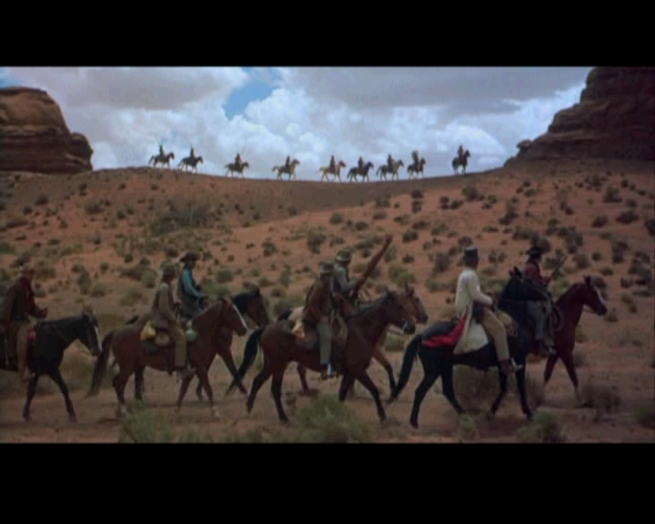

Slide 22
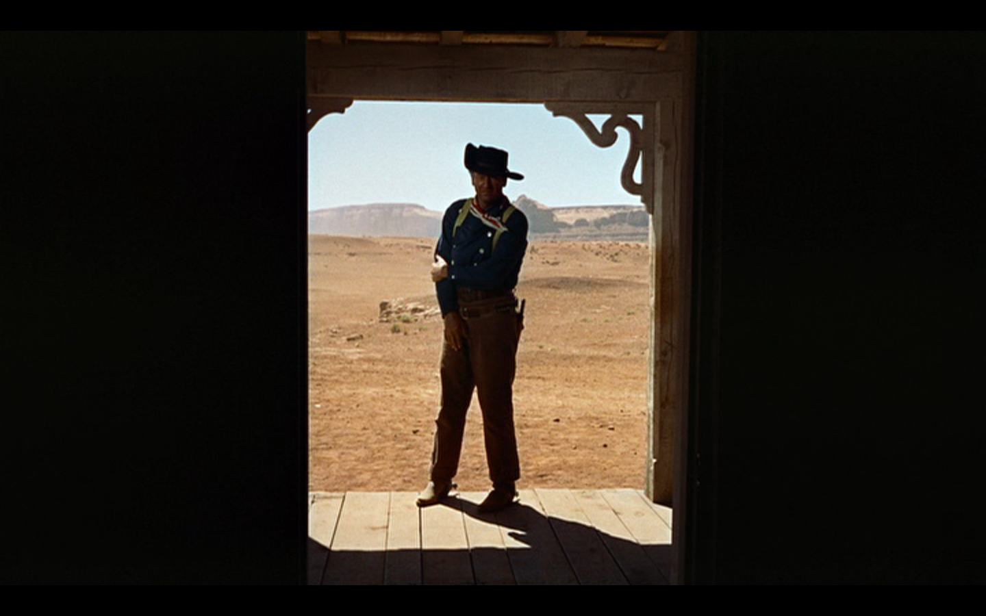

Slide 23
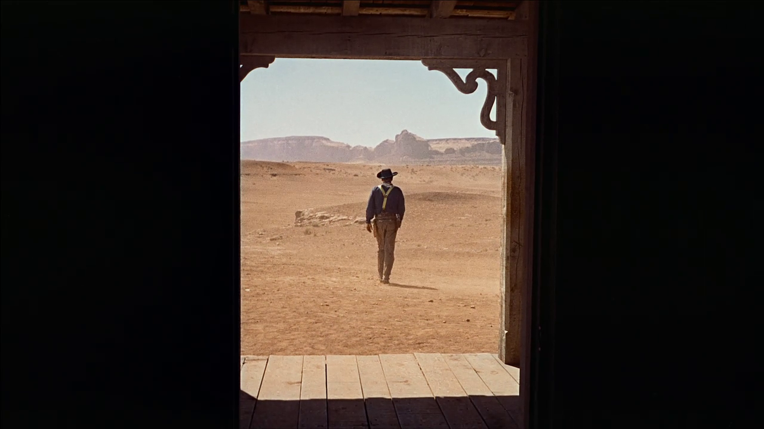

Slide 24
Building Blocks for Film
Shot – one uninterrupted run of the camera (same as a take)
Scene - the action in a single location and continuous time. (Meaning a scene changes with TIME change or LOCATION change)
Sequence - series of scenes that form a distinct narrative unit
Clapping exercise – The Bourne Supremacy (exiting Naples sequence)

