Slide 1

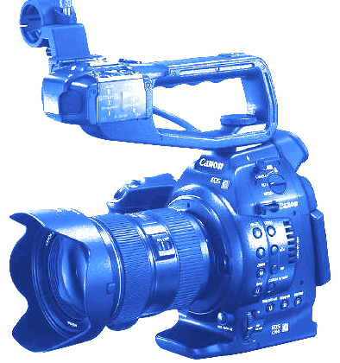
THE CANON C100

Slide 2
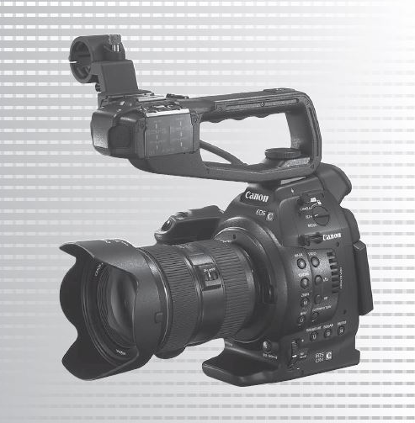
THE CANON C100
OBSERVATIONS:
VERY NICE CAMERA THAT IS A CROSS BETWEEN A DSLR AND A CINEMA CAMERA.

Slide 3
THE CANON C100
IT DOES & HAS EVERYTHING A DSLR HAS BUT HAS ALL THE FEATURES THAT YOU NEED TO SHOOT VIDEO WITH A ‘CINEMA’ LOOK - AND SOUND.

Slide 4

THE CANON C100
LET’S LOOK AT THE MAIN SIDE FIRST:

Slide 5
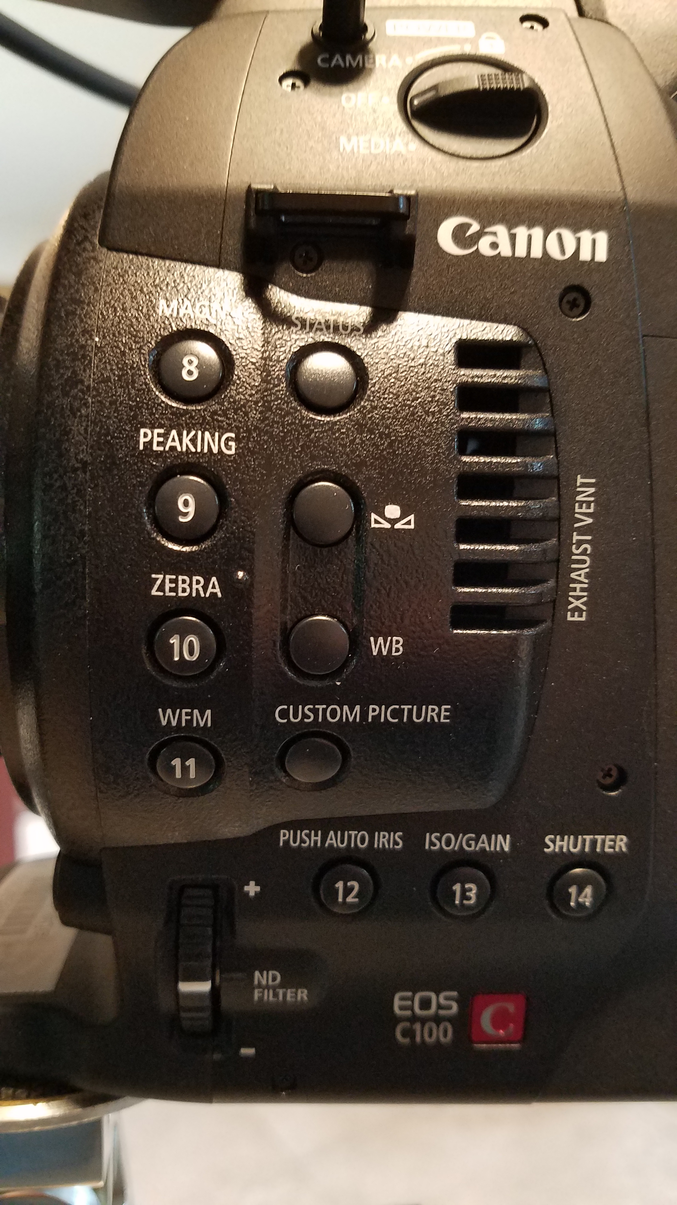
CANON C100
MOST THINGS SHOULD BE EASILY IDENTIFIABLE:
PEAKING
ZEBRA
WFM
IS0
SHUTTER

Slide 6
CANON C100
WHAT IS THIS SYMBOL?

Slide 7
CANON C100
MANUAL WHITE BALANCE.

Slide 8
CANON C100
HOLD UP A WHITE CARD AND PUSH THIS.

Slide 9
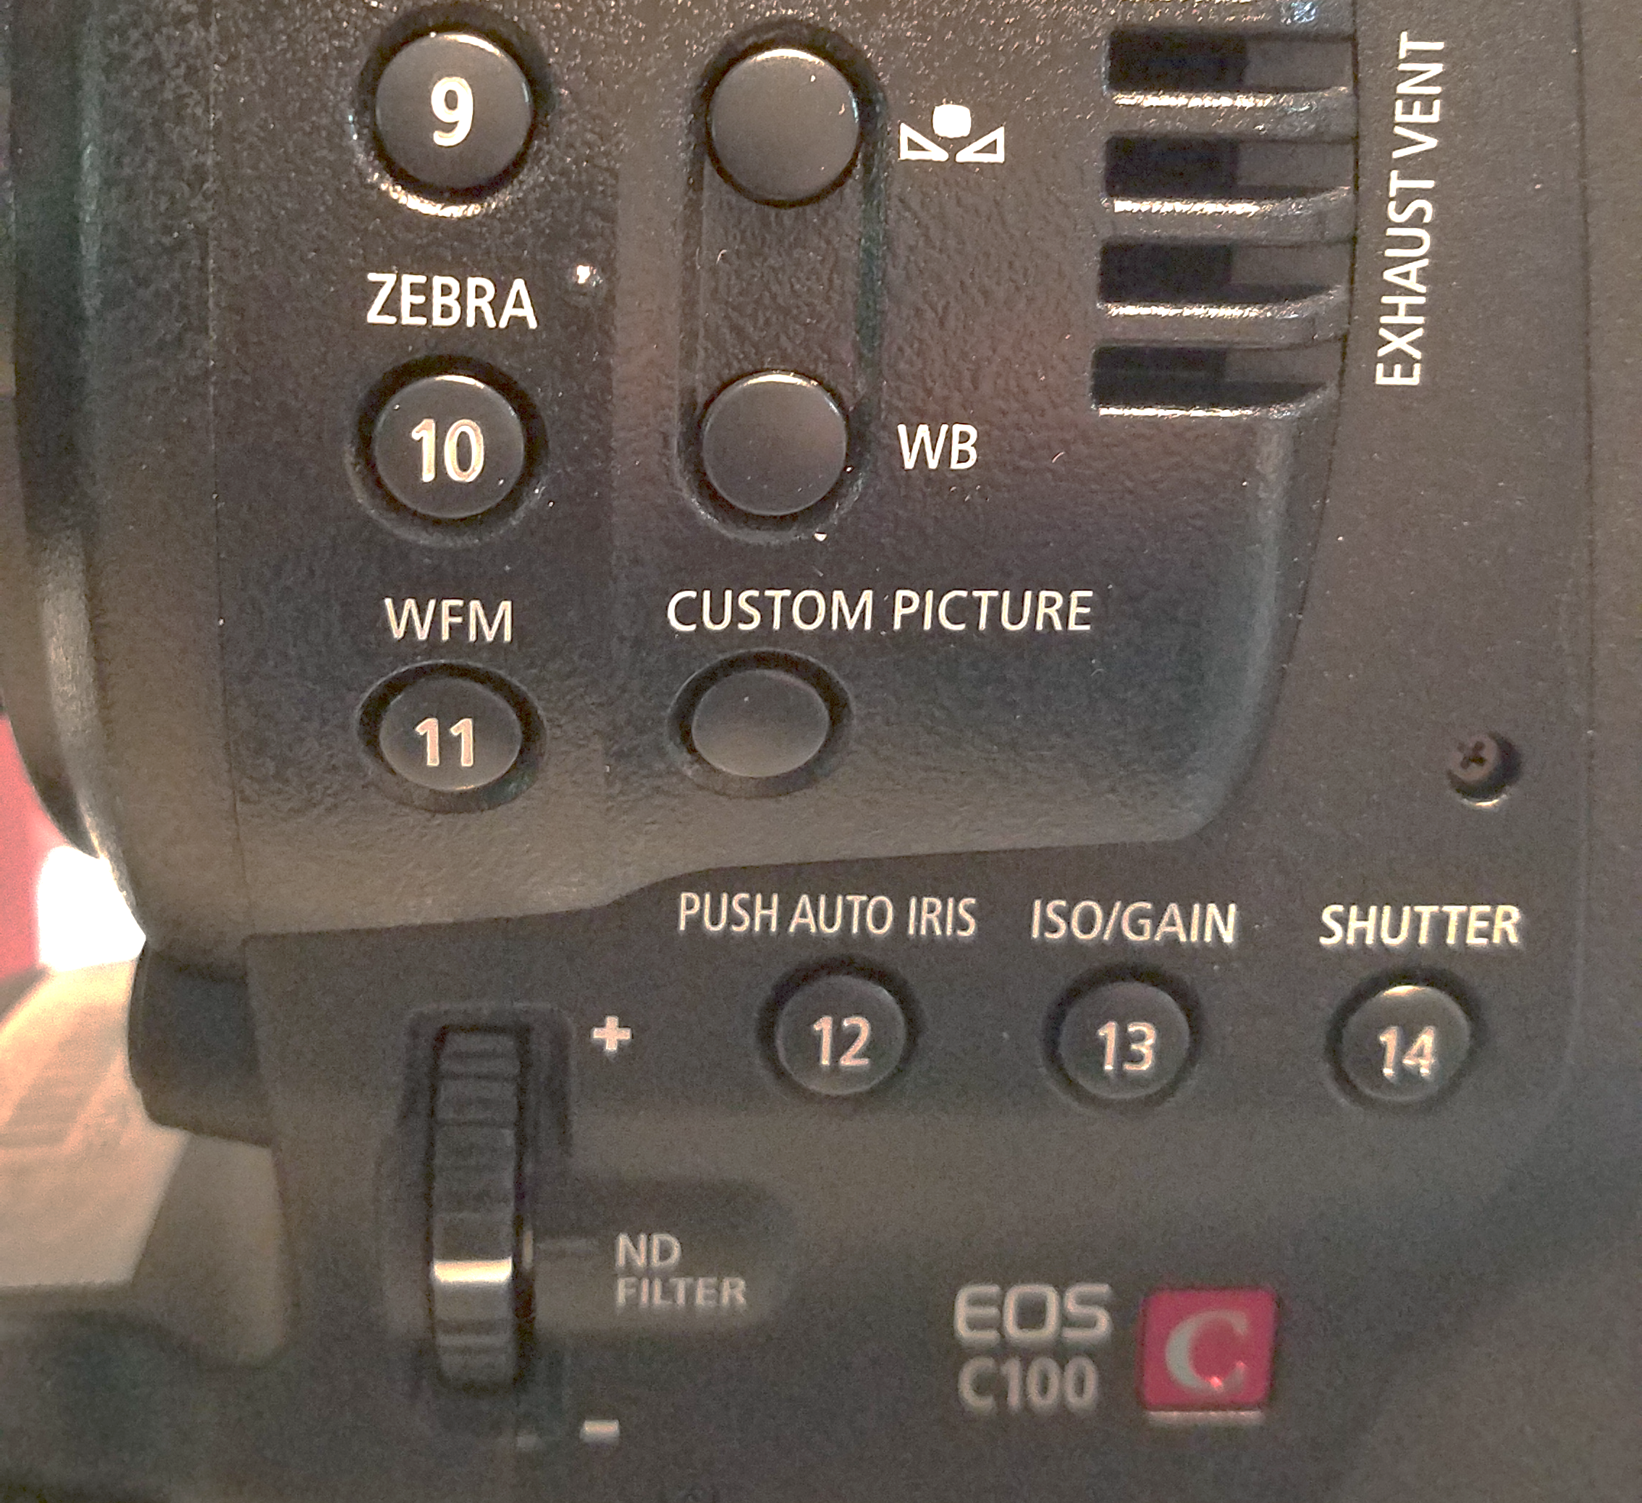
CANON C100
THIS IS GREAT:
INTERNAL ND FILTERS
TURN THE KNOB AND YOU HAVE 3 ND FILTERS.

Slide 10
CANON C100
THE ‘PUSH AUTO IRIS’ BUTTON ONLY WORKS IF YOU HAVE A CANON LENS THAT COMMUNICATES TO THIS CAMERA.

Slide 11
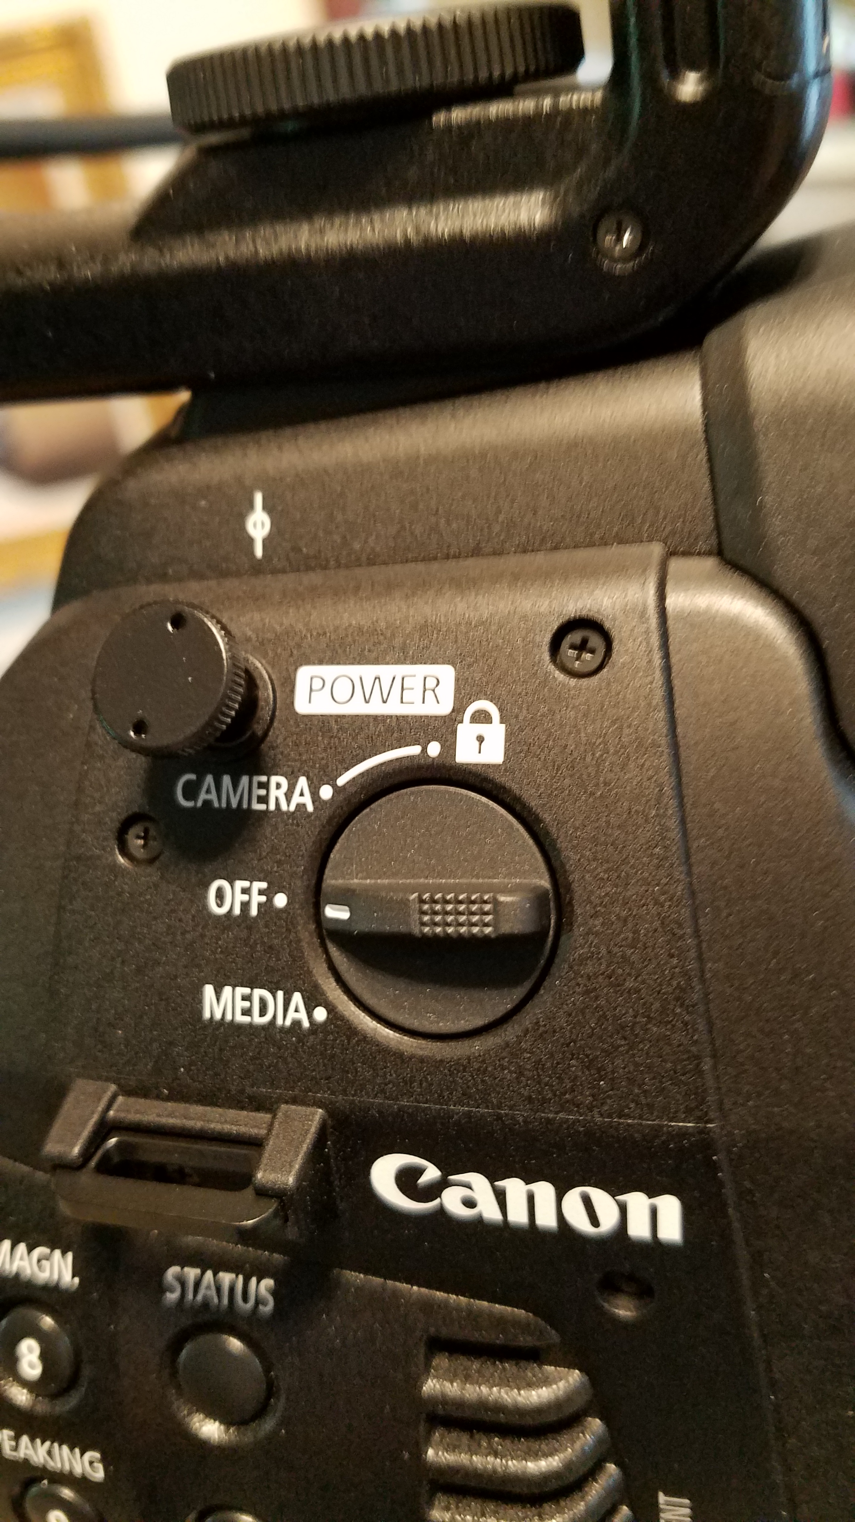
CANON C100
THE POWER SWITCH IS AT THE TOP, ABOVE THE BUTTONS WE WERE JUST LOOKING AT.

Slide 12
CANON C100
QUESTION:
WHAT IS THIS LITTLE GUY?

Slide 13
CANON C100
ANSWER:
THE EXACT CENSOR SPOT. THE FOCUS SWEET SPOT.

Slide 14
CANON C100
NEXT QUESTION:
WHAT IS THIS KNOB? IT ISN’T A BUTTON OR SWITCH, SO WHAT IS IT?

Slide 15
CANON C100
ANSWER:
IT IS A ‘HOOK’ TO HOLD YOUR TAPE MEASURE IF YOU ARE USING A TAPE MEASURE FOR FOCUSING.
VERY NICE!!!

Slide 16
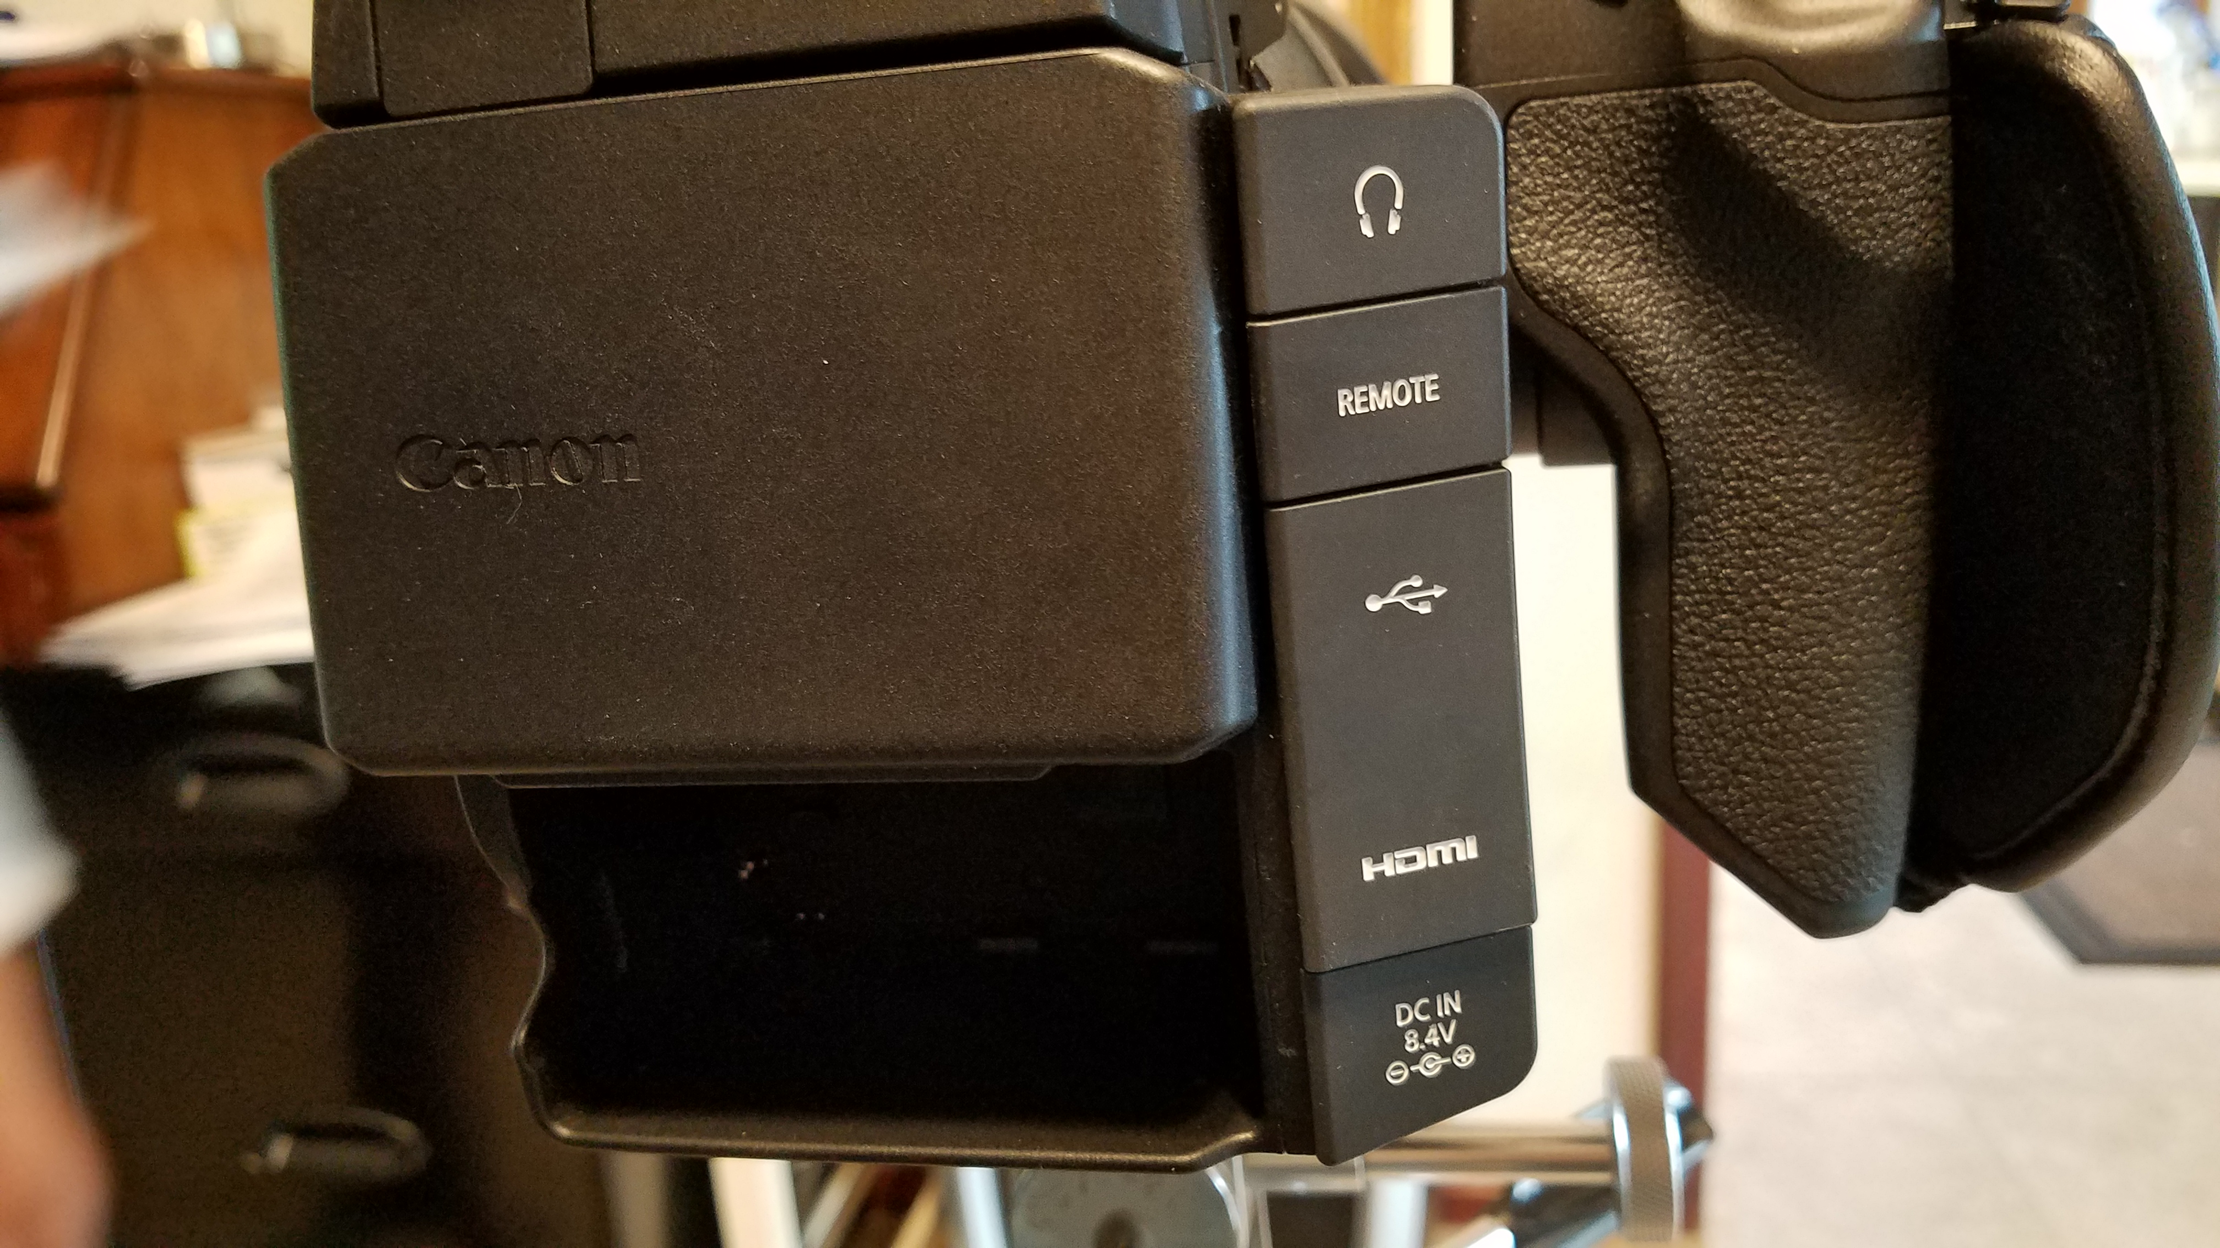
CANON C100
BACK OF CAMERA:
LCD CLOSED UP.
AND THE BATTERY SLOT AT THE
BOTTOM.

Slide 17
CANON C100
BACK OF CAMERA:
MOST OF THE OUTPUTS AND INPUTS ARE ON THE RIGHT, CLEARLY LABELED.

Slide 18
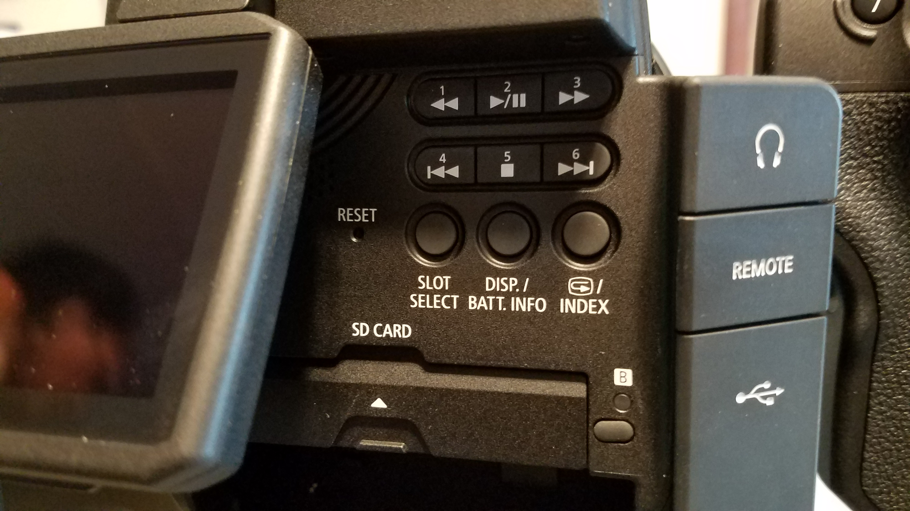
CANON C100
BACK OF CAMERA:
WHEN YOU OPEN UP THE LCD, YOU SEE ALL THE PLAYBACK CONTROLS.

Slide 19
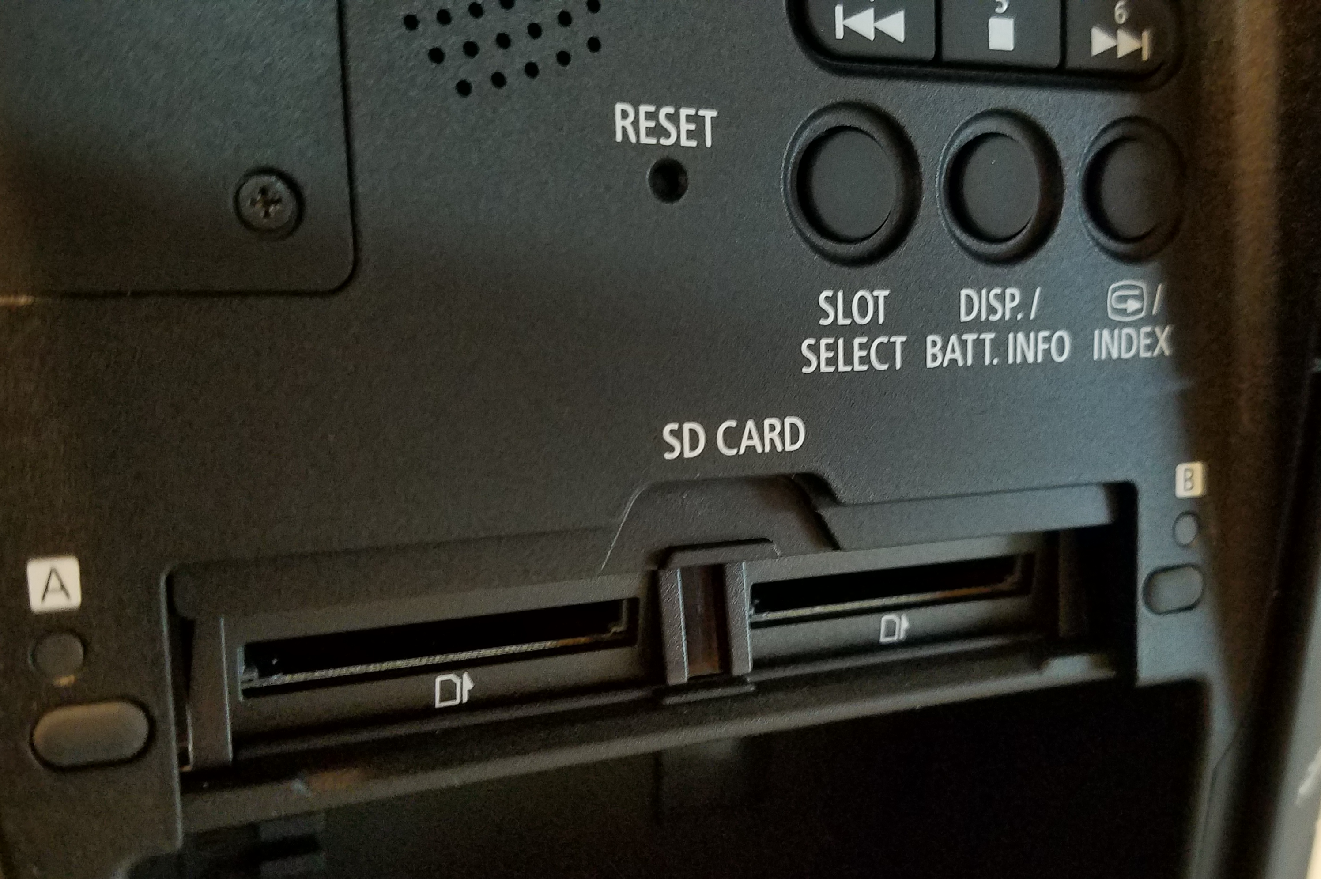
CANON C100
BACK OF CAMERA:
THIS IS ALSO WHERE YOU HAVE YOUR SD CARD SLOTS.

Slide 20
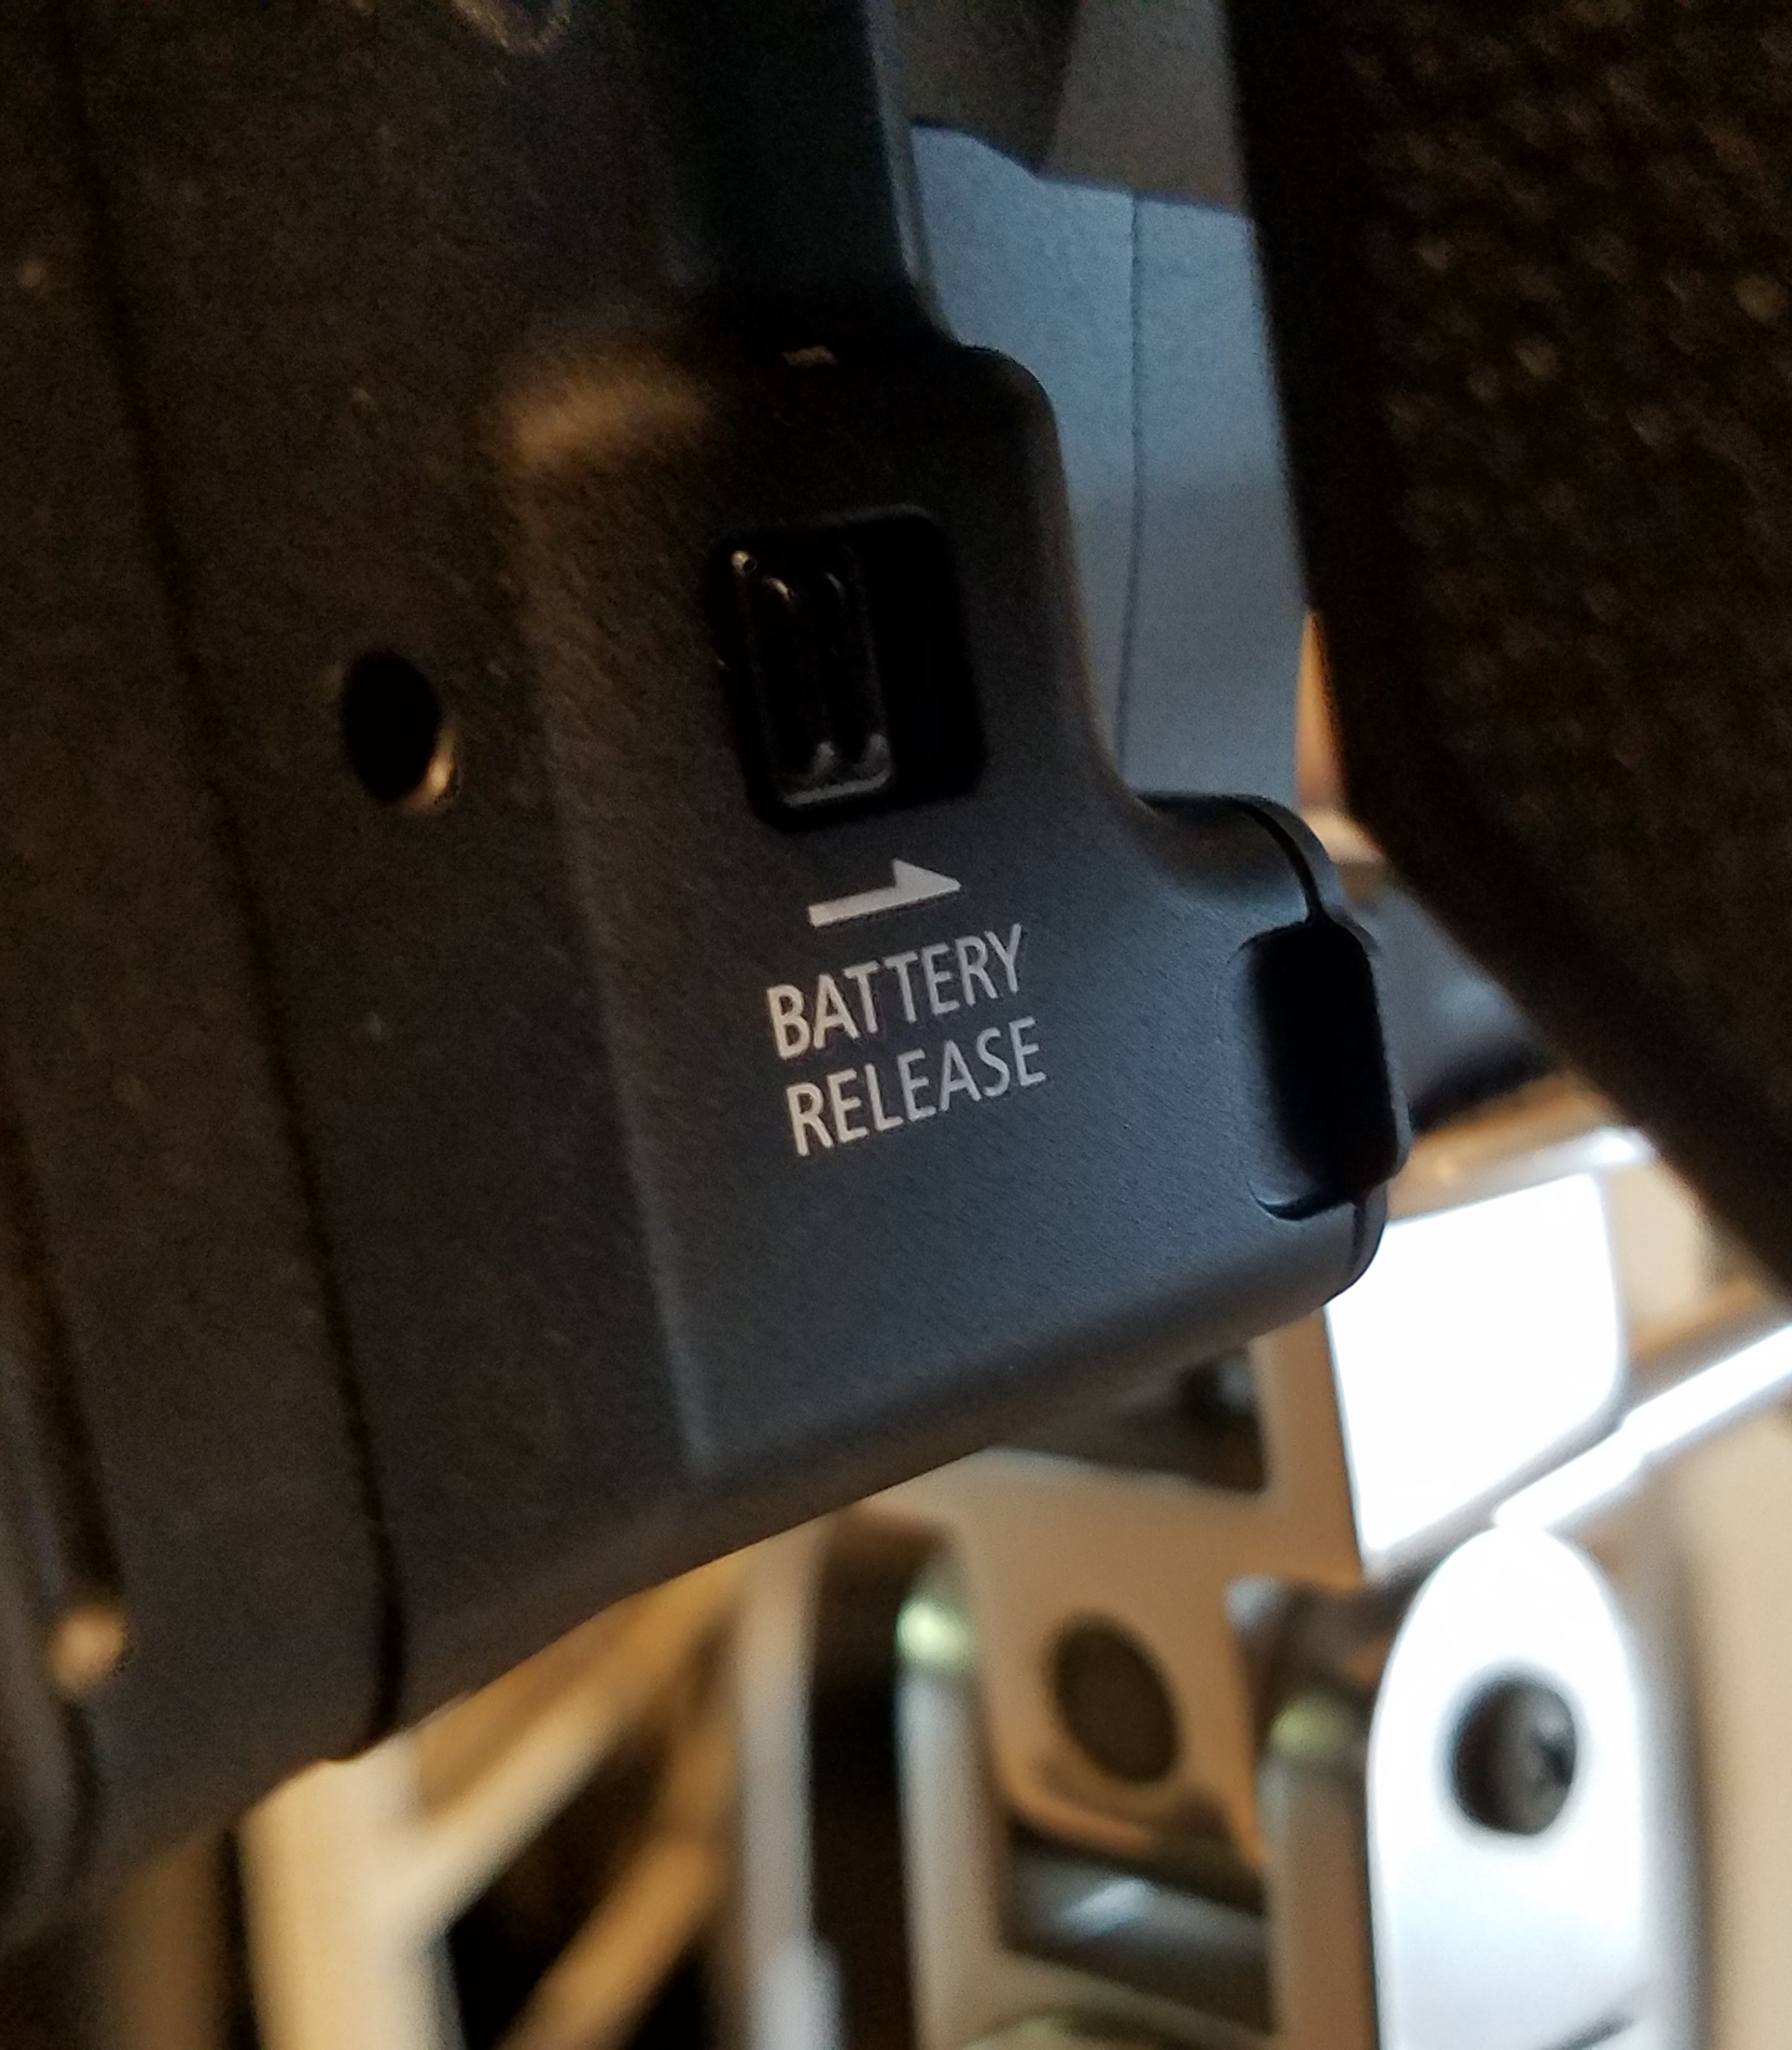
CANON C100
JUST UNDER THE HANDLE (SORTA HIDDEN) ON THE RIGHT, IS THE BATTERY RELEASE BUTTON.

Slide 21
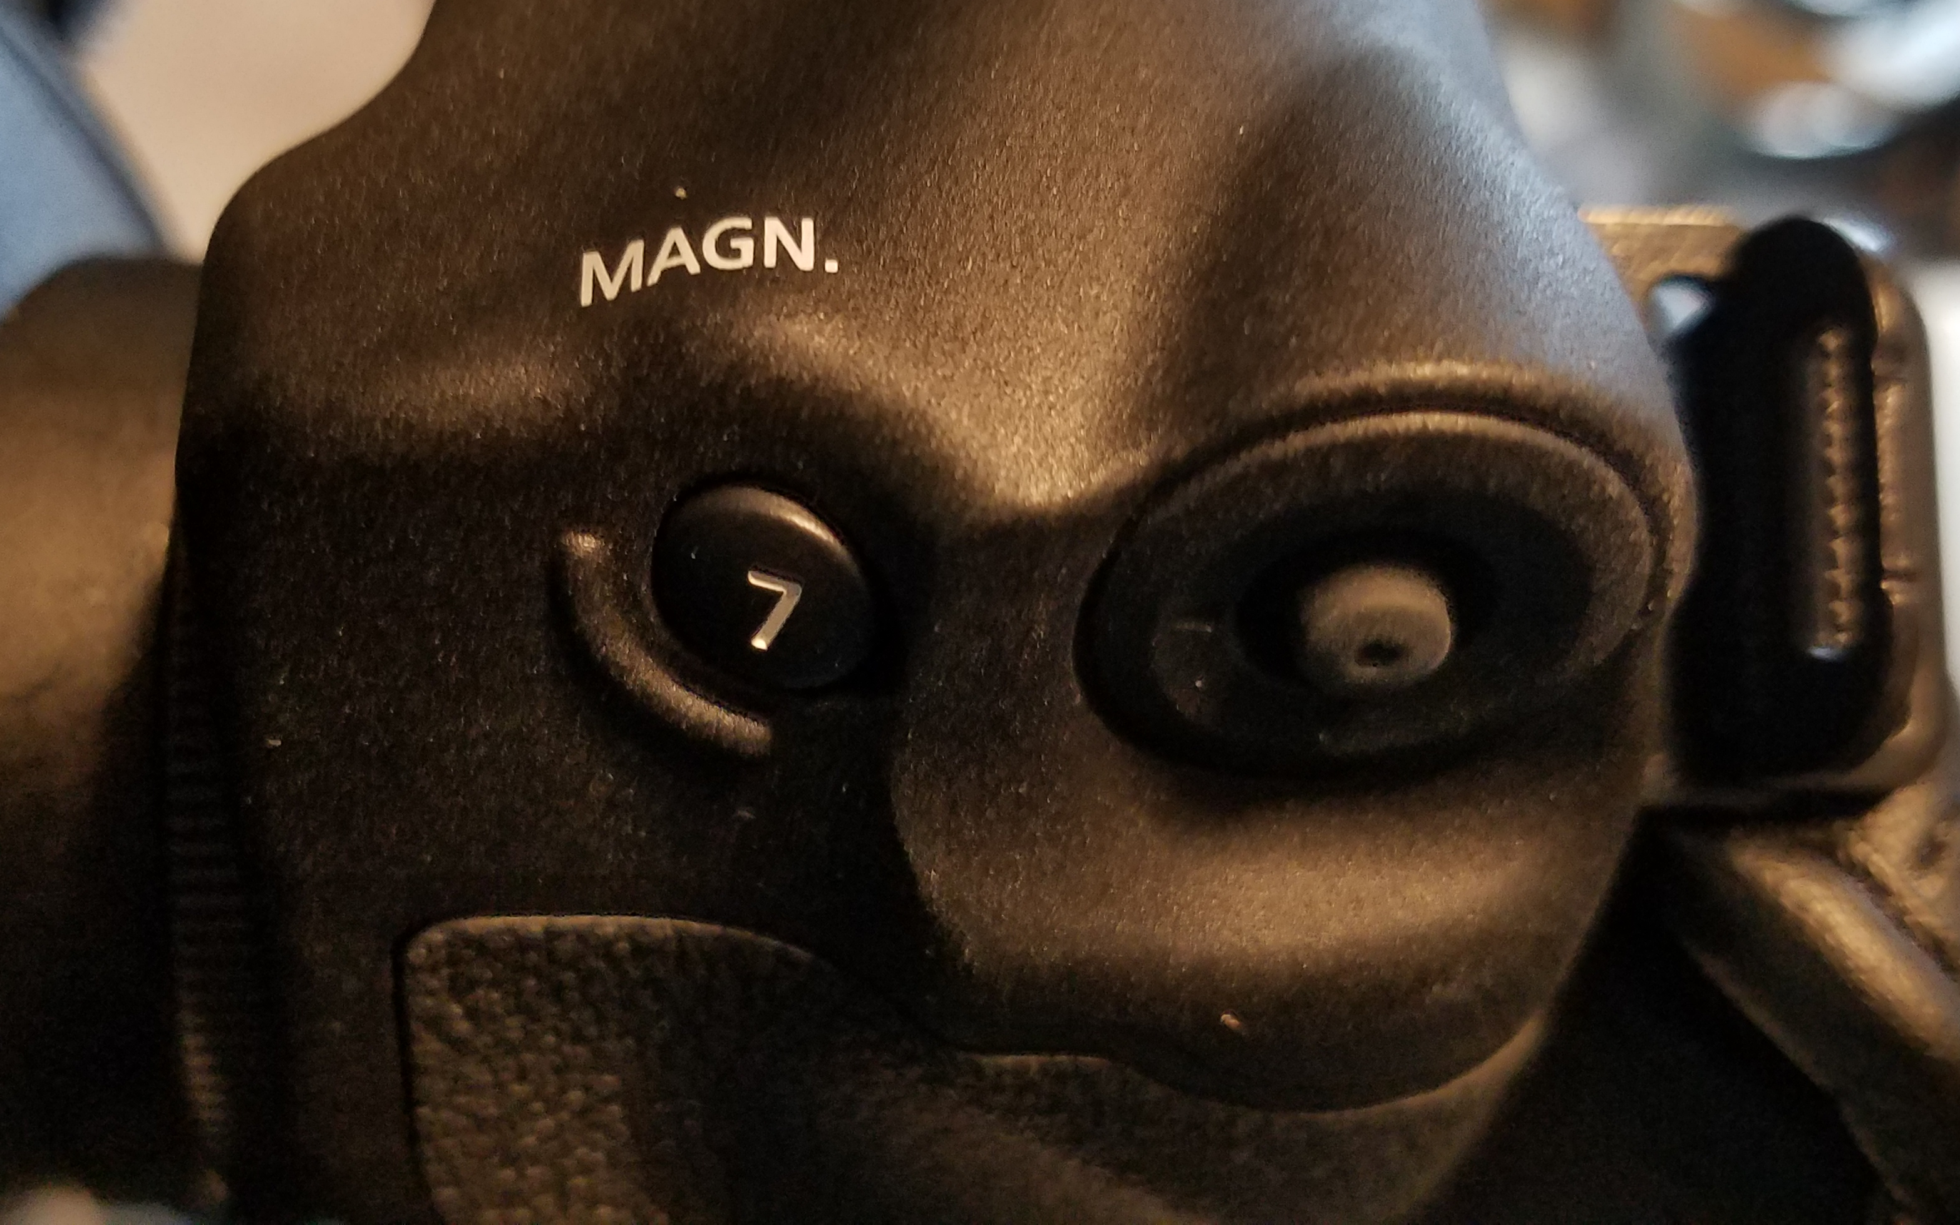
CANON C100
ON THE BACK OF THE HANDLE GRIP IS ONE OF THE MOST IMPORTANT PARTS OF THE C100:
THE JOYSTICK

Slide 22
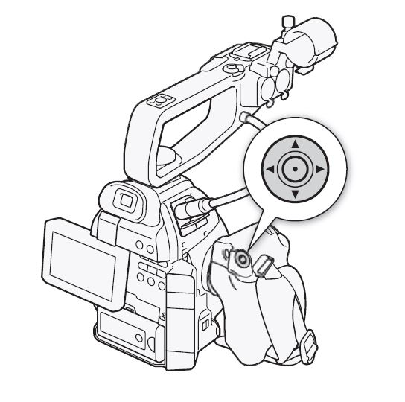
CANON C100
THE JOYSTICK IS SUPER DUPER IMPORTANT.
YOU WILL BE USING THIS A LOT!

Slide 23
CANON C100
ALSO THE MAGNIFYER TO HELP WITH FOCUSING.

Slide 24
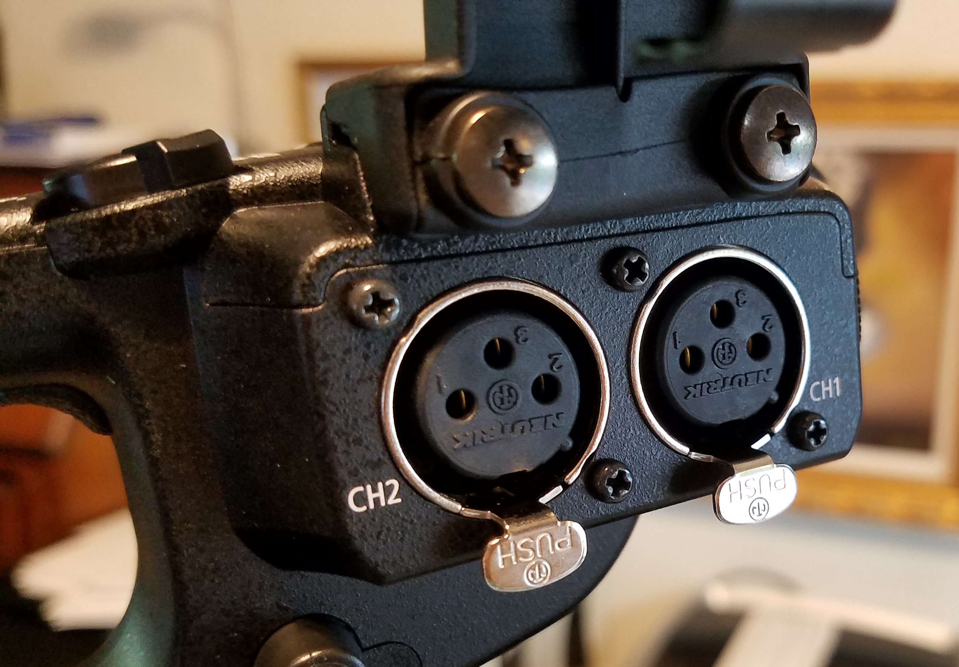
CANON C100
ON THE UPPER RIGHT SIDE IS THE TWO XLR INPUTS.
HERE’S SOMETHING KINDA CRAZY:
CHANNEL 2 IS ON THE LEFT. BEWARE!

Slide 25
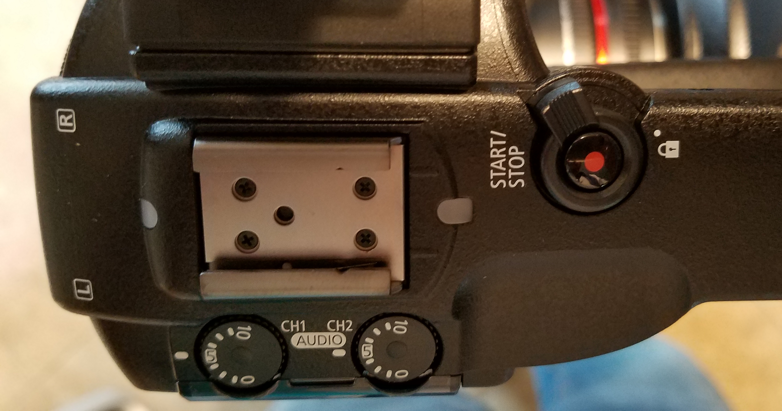
CANON C100
ON TOP OF THE UPPER HANDLE ARE THE MIC LOUDNESS KNOBS AND THE RECORD BUTTON

Slide 26
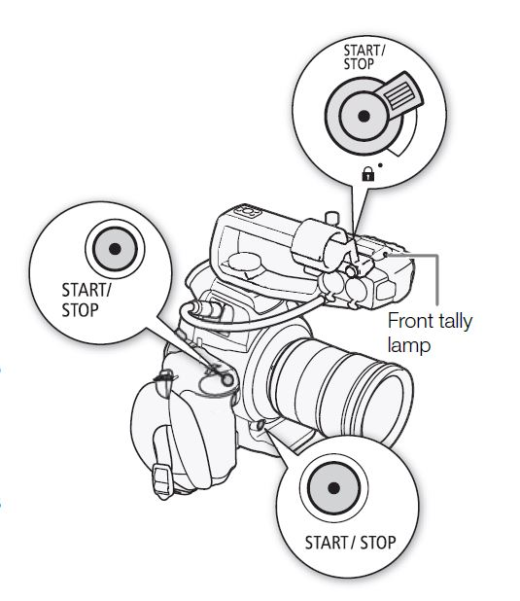
CANON C100
BY THE WAY, THERE ARE THREE PLACES TO HIT RECORD. JEESH.

Slide 27
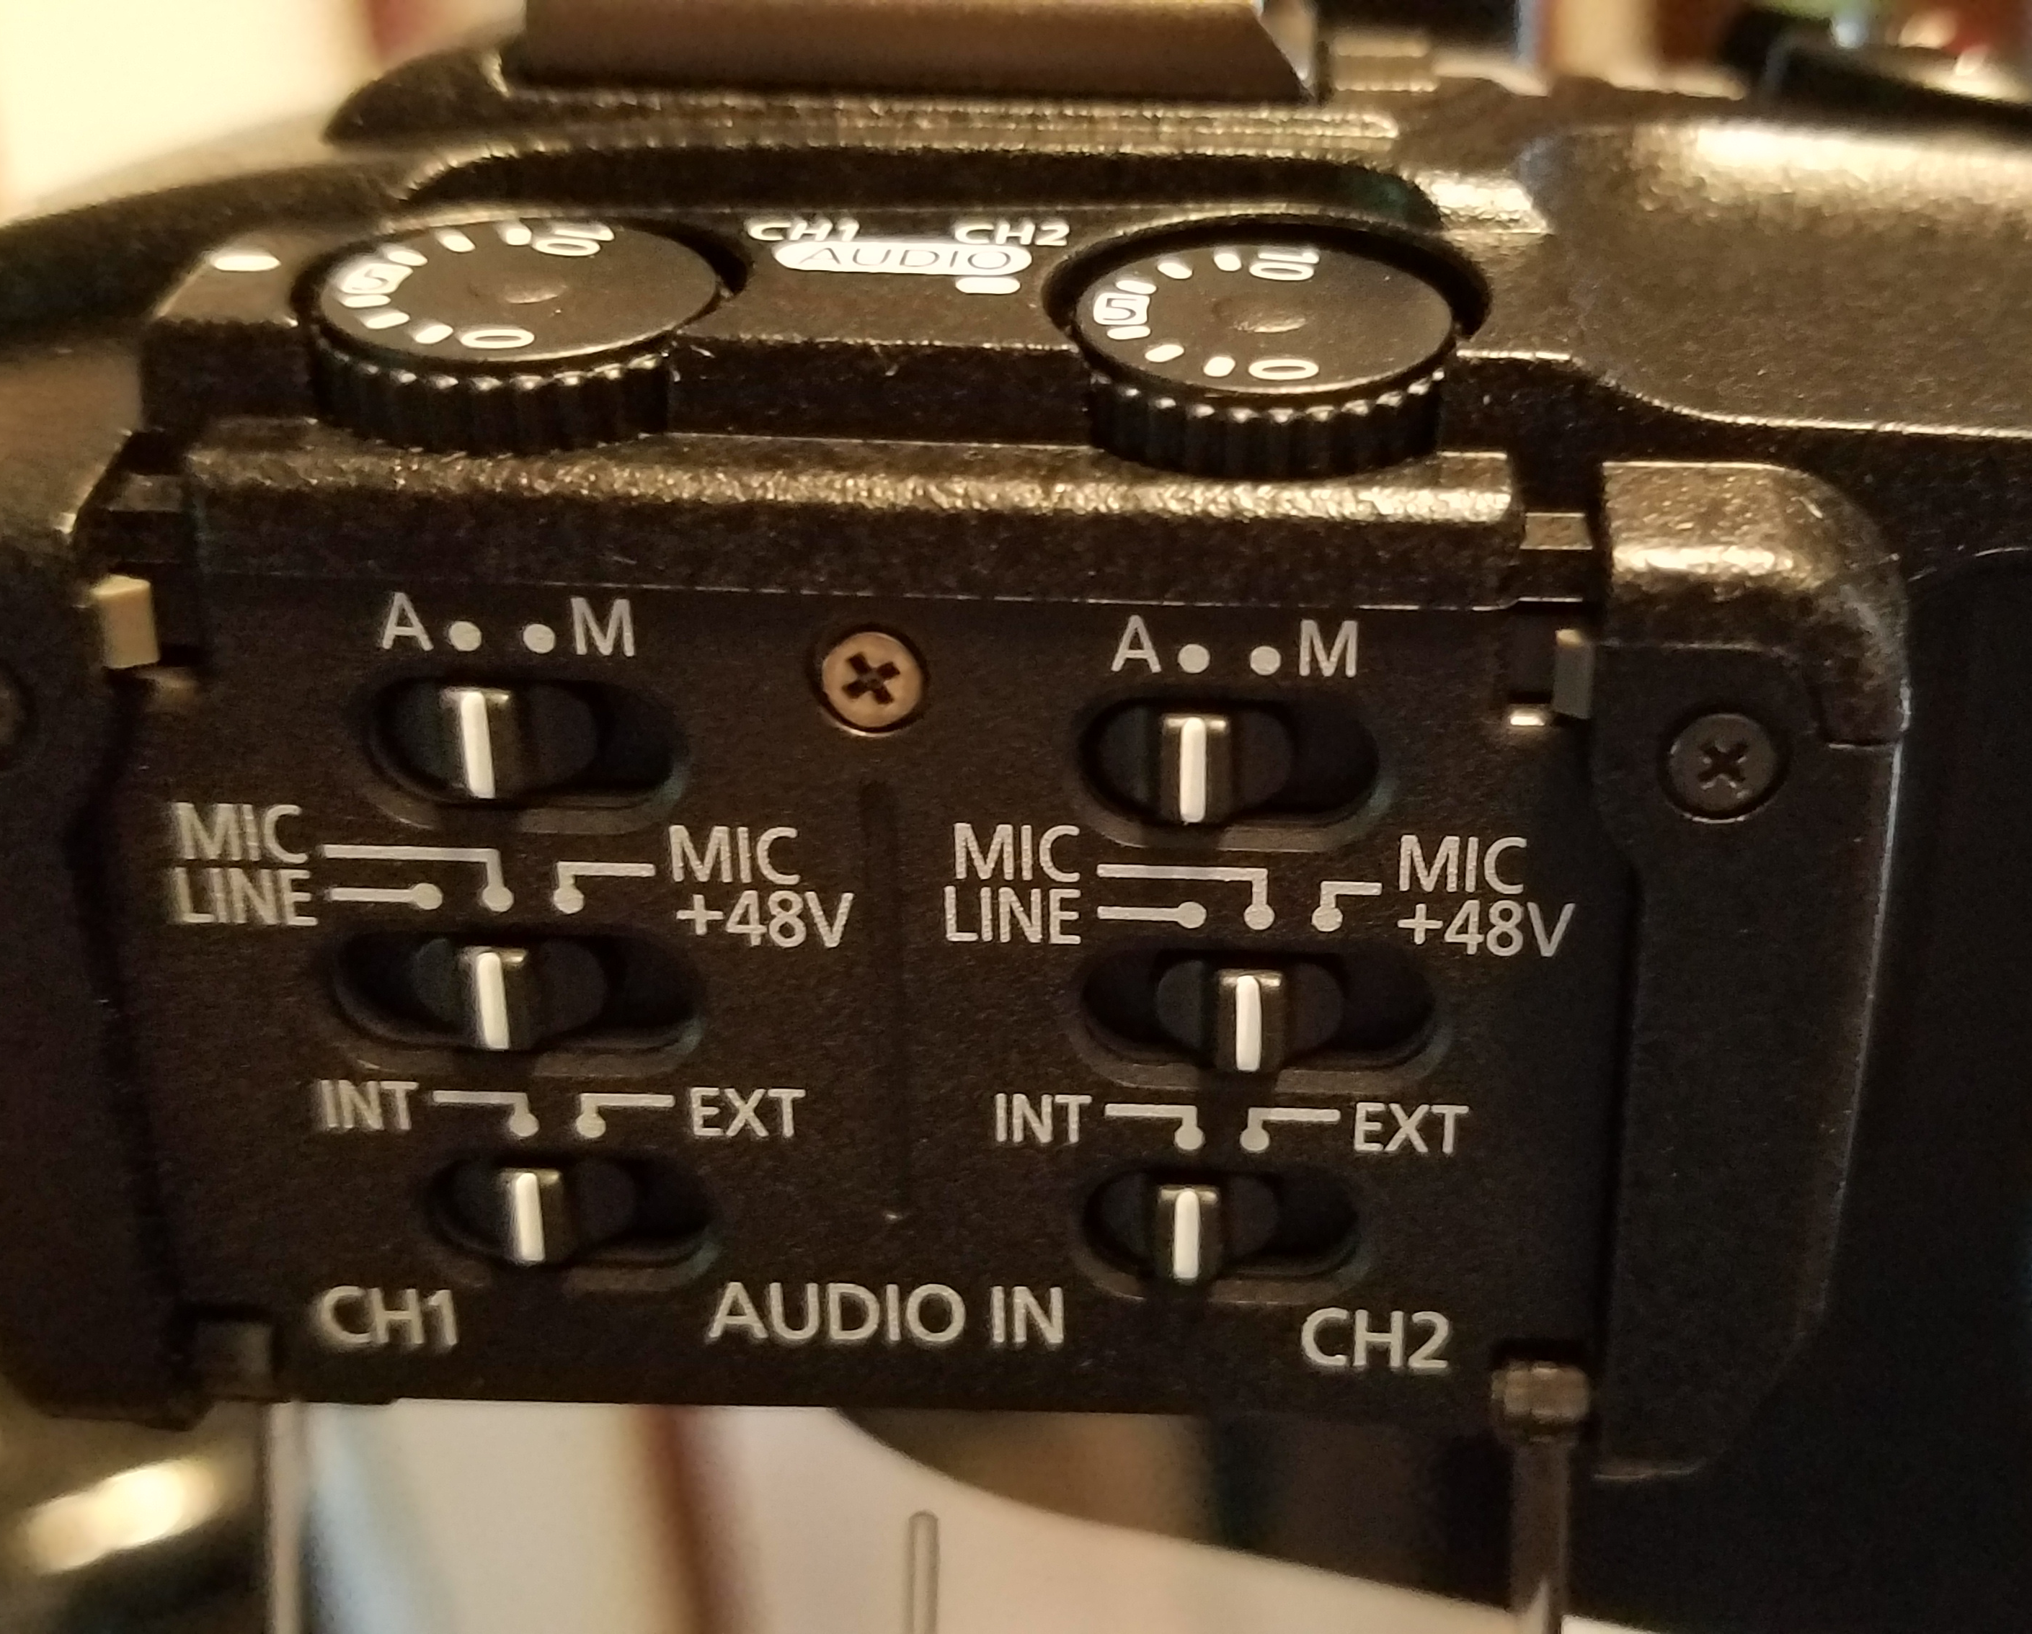
CANON C100
ALSO ON THE UPPER HANDLE, ALL THE MIC STUFF FOR CHANNELS ONE & TWO.

Slide 28
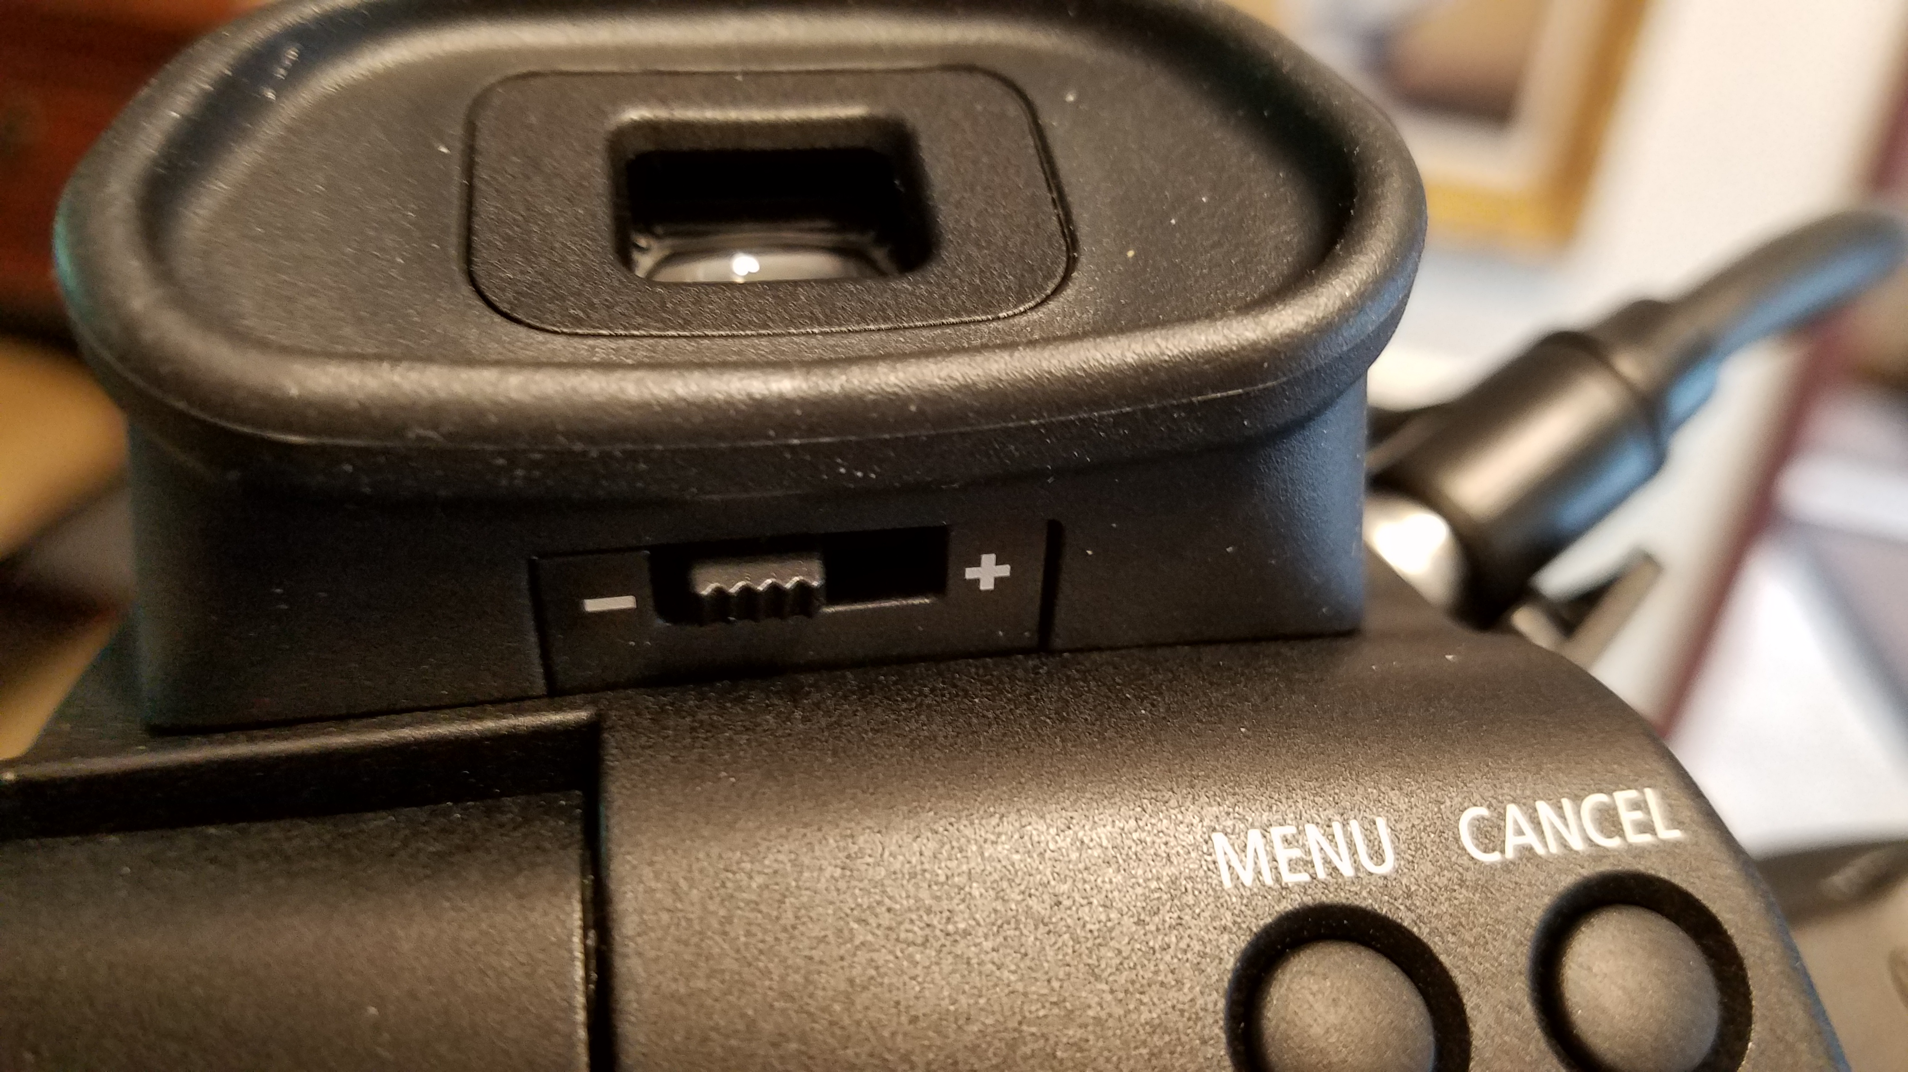
CANON C100
BESIDES AN LCD, YOU ALSO HAVE A VIEWFINDER IN THE BACK.
TO SET THE FOCUS TO YOUR EYE, THERE IS A KNOB UNDER THE VF.

Slide 29
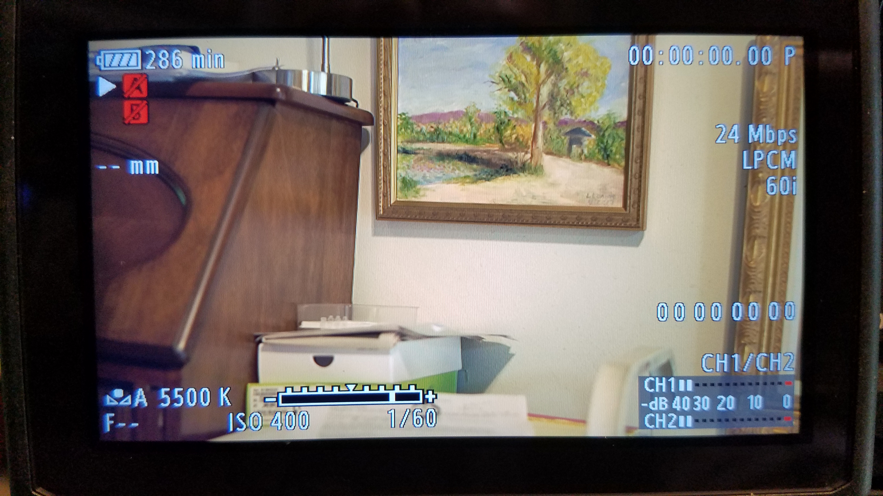
CANON C100
NOW LET’S LOOK AT THE LCD READOUT TO SEE WHAT IS WHAT:

Slide 30
THE BASE ISO ON
THE C100 IS 800

Slide 31
LET’S GO TO THE MENU BUTTON, IN THE BACK UNDER THE VF.

Slide 32
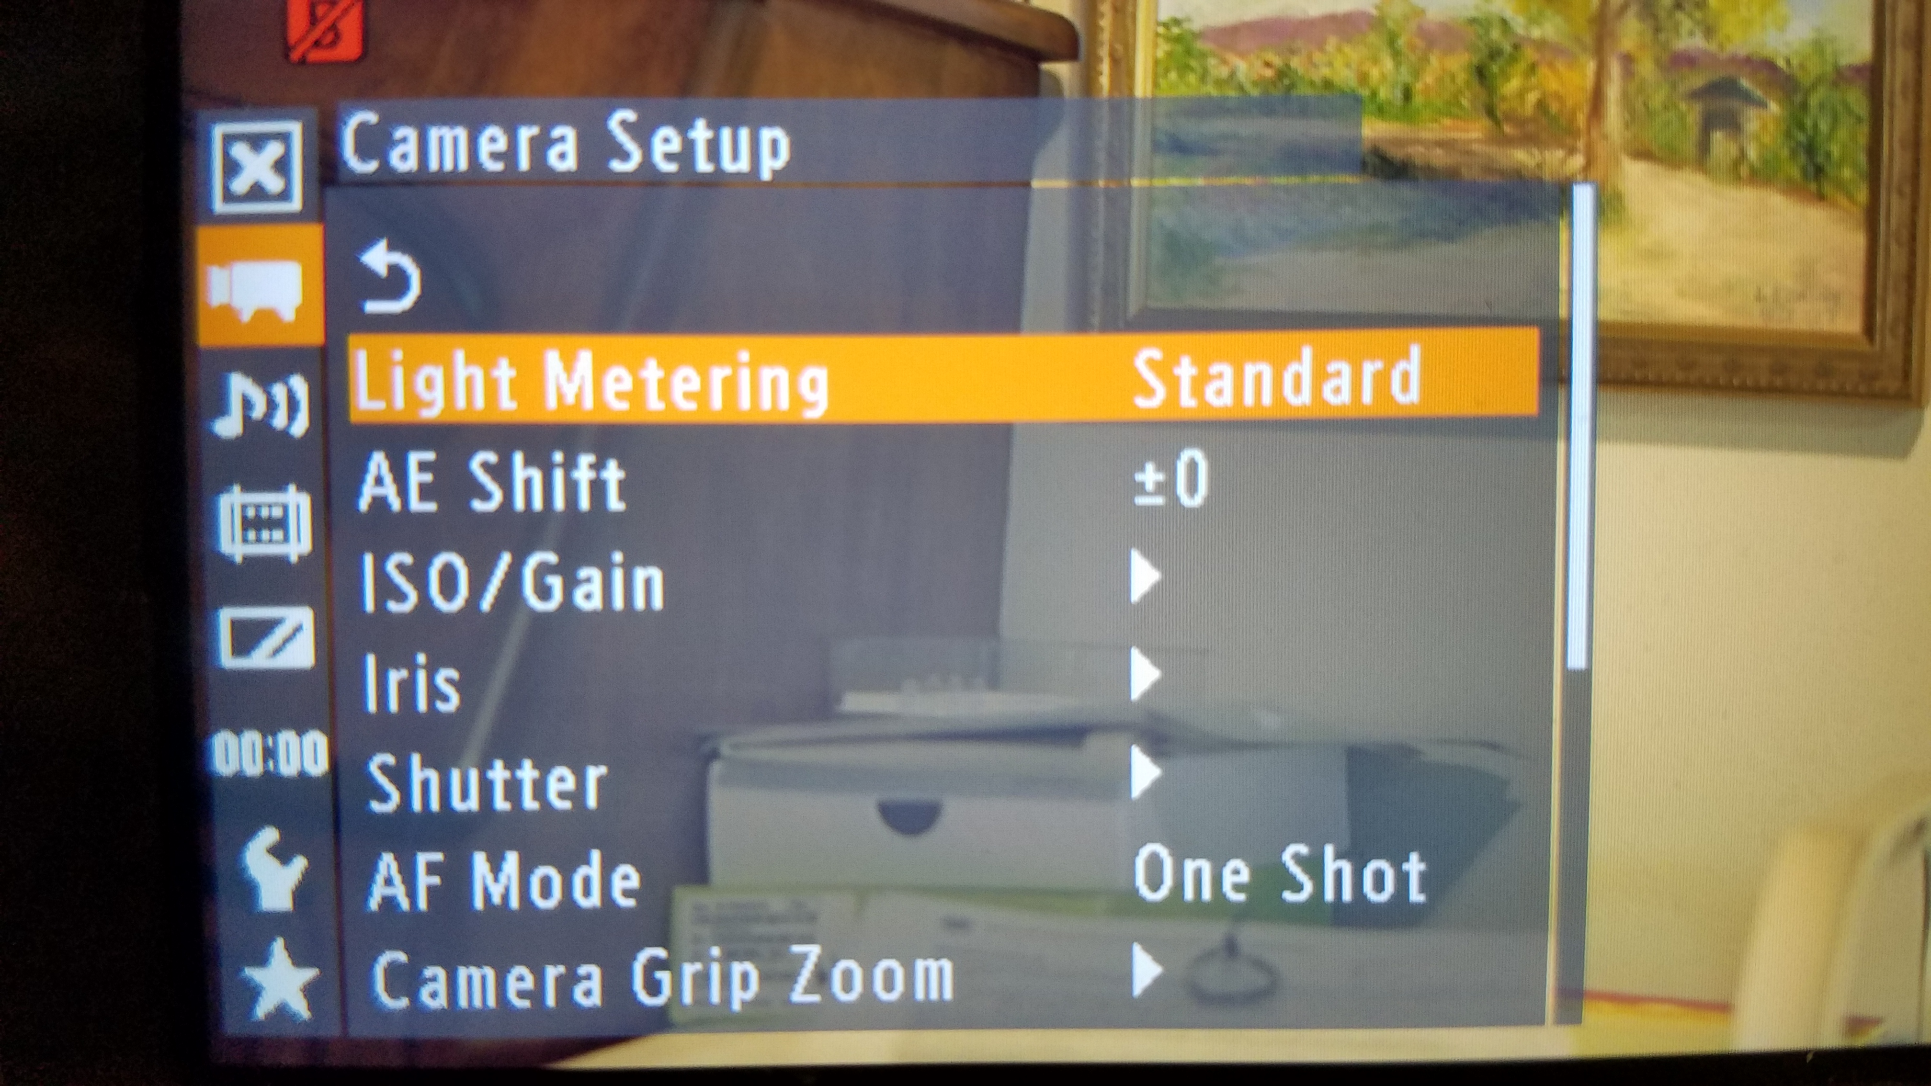
TOP MENU ITEM: CAMERA SETUP
LOOK AT ‘LIGHT METERING’ –
STANDARD IS USUALLY FINE.

Slide 33
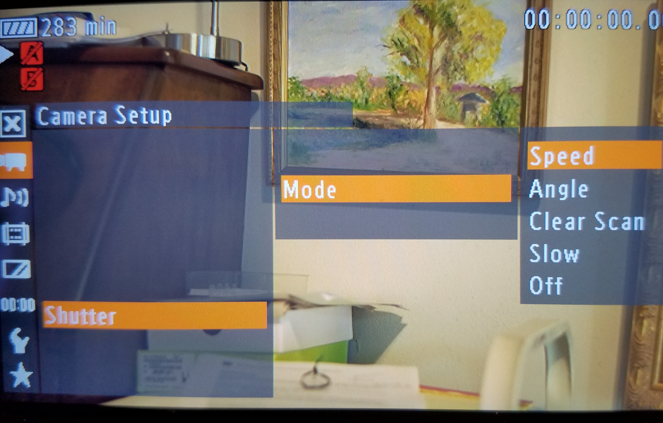
NEXT: SHUTTER CHOOSE SPEED
YOU’RE MORE USE TO IT.

Slide 34
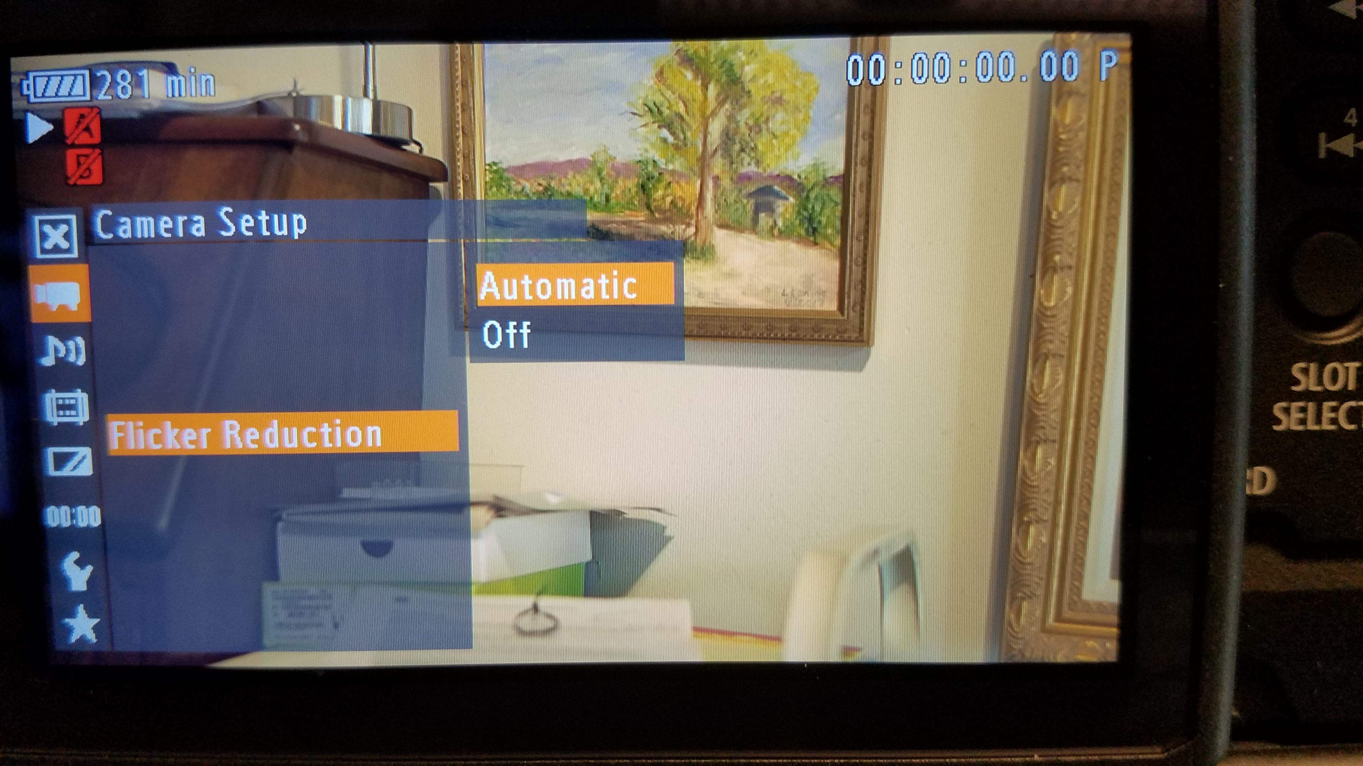
‘FLICKER REDUCTION’ - SET IT TO AUTOMATIC.
IF YOU SHOOT A TV SCREEN OR UNDER A BAD FLOURESCENT LIGHT, IT WILL TRY AND REDUCE FLICKER.

Slide 35
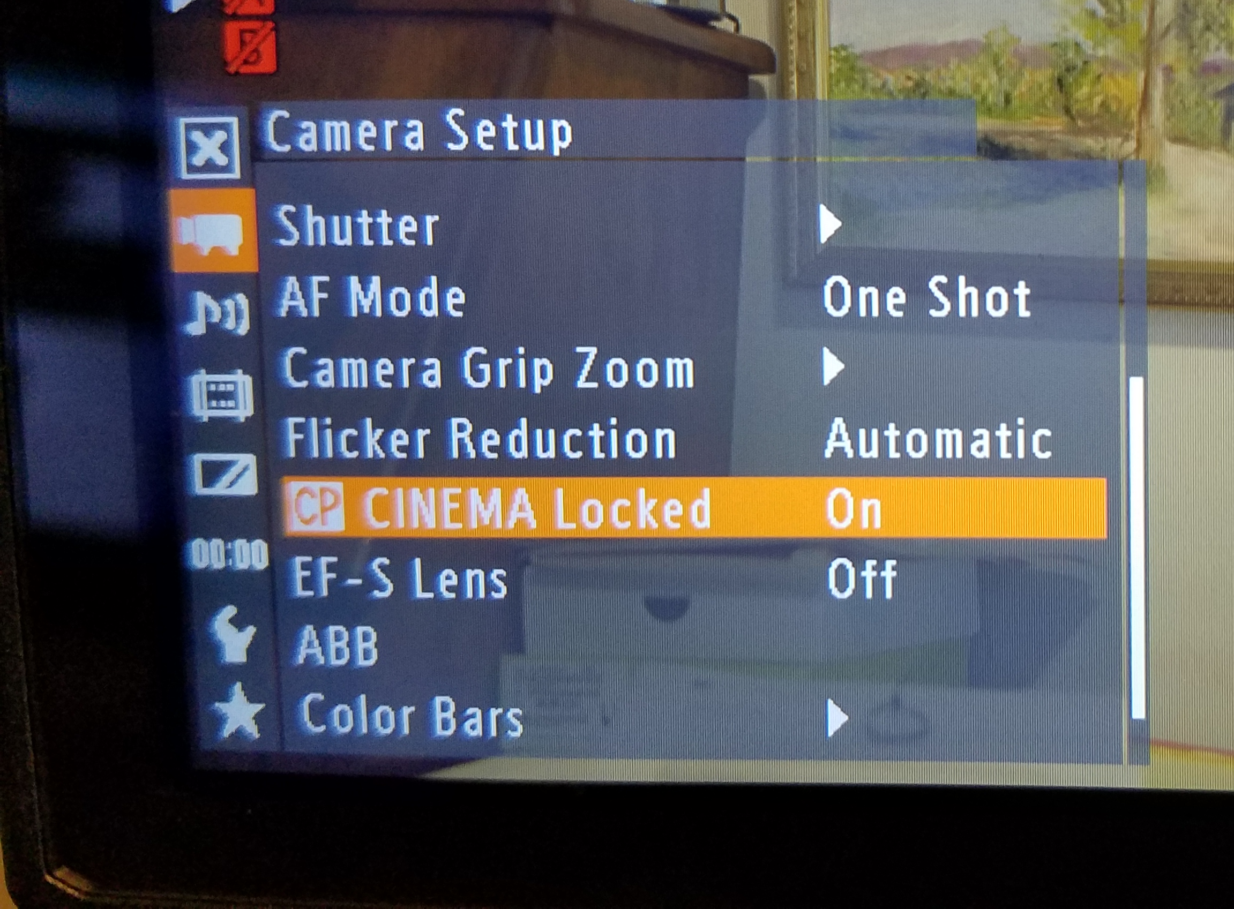
CINEMA LOCKED:
THAT SHOULD BE OFF UNLESS YOU WANT TO USE THE SPECIAL SETTINGS PRESETS.

Slide 36
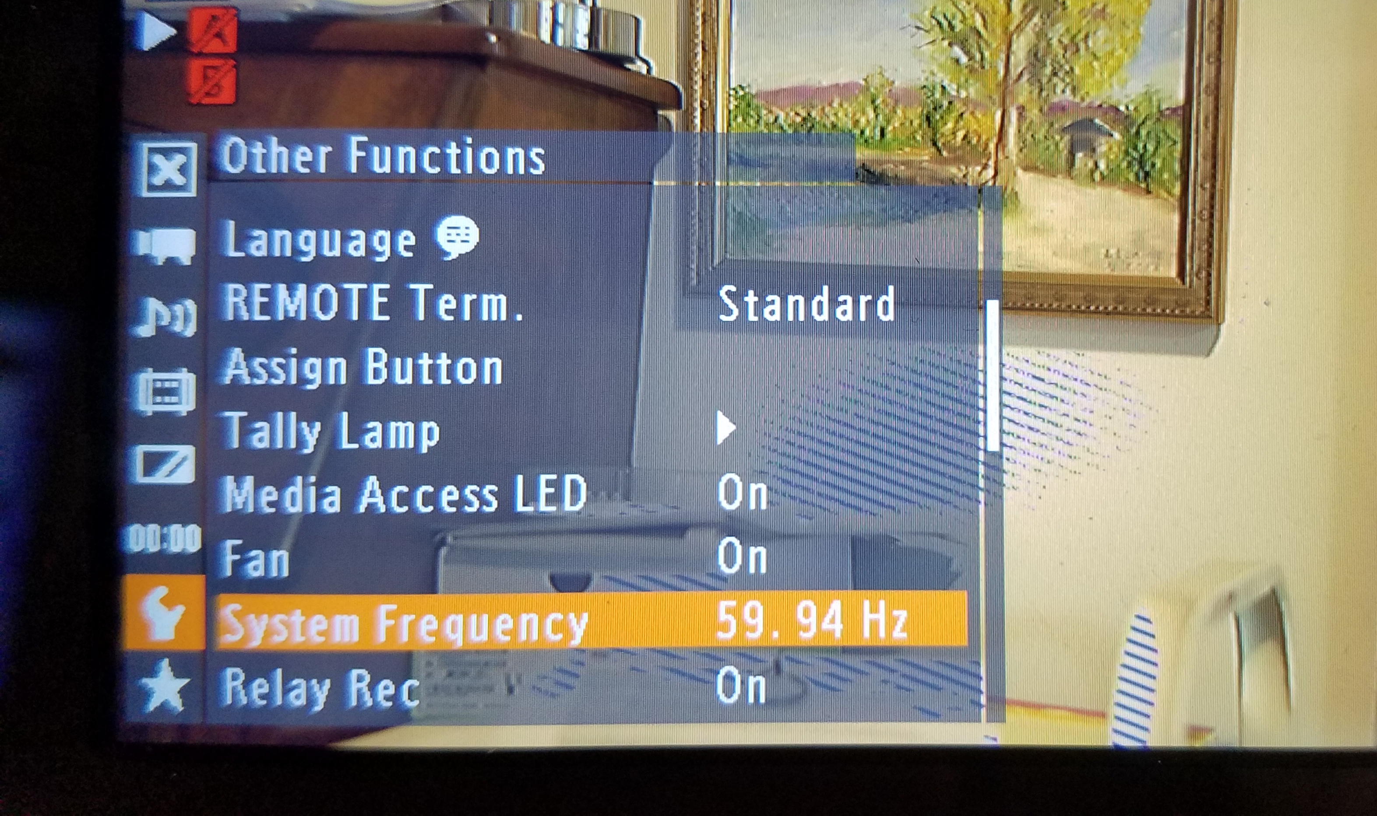
OTHER FUNCTIONS:
SYSTEM FREQUENCY - MAKE SURE IT IS SET TO 59.94 HZ. THAT IS THE U.S. FREQUENCY.

Slide 37
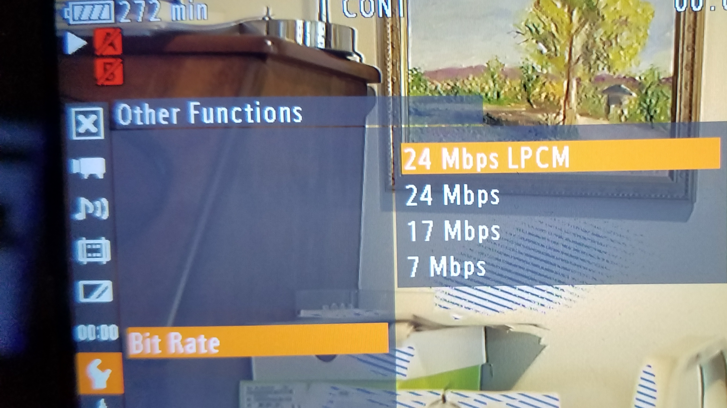
OTHER FUNCTIONS:
SUPER DUPER IMPORTANT!
THE HIGHER THE BETTER. ALSO, LPCM IS BETTER AUDIO.
MAKE SURE IT IS
HERE, AND LEAVE
IT HERE.

Slide 38
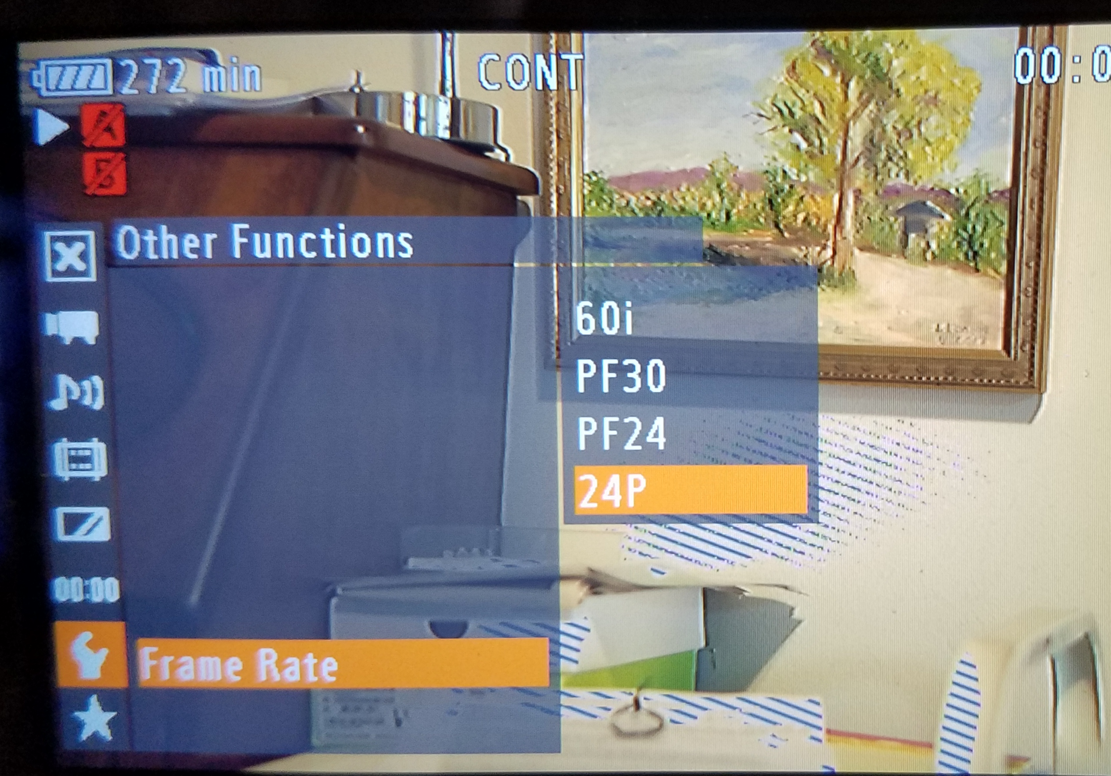
OTHER FUNCTIONS:
FRAME RATE. ALSO IMPORTANT!
SET IT TO 24P.
NEVER ANY OF THE
OTHERS. THEY SUCK.
THAT’S WHY THEY
CALL THIS A CINEMA
CAMERA.

Slide 39
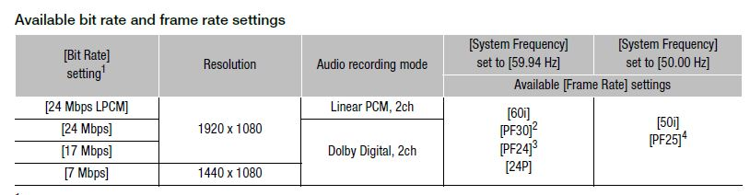
HERE ARE THE AVAILABLE FRAME RATES & RESOLUTION:
NOT MANY CHOICES AT ALL. TRUST ME. KEEP IT AT: 24Mbps LPCM & 24P. THAT’S IT.

Slide 40
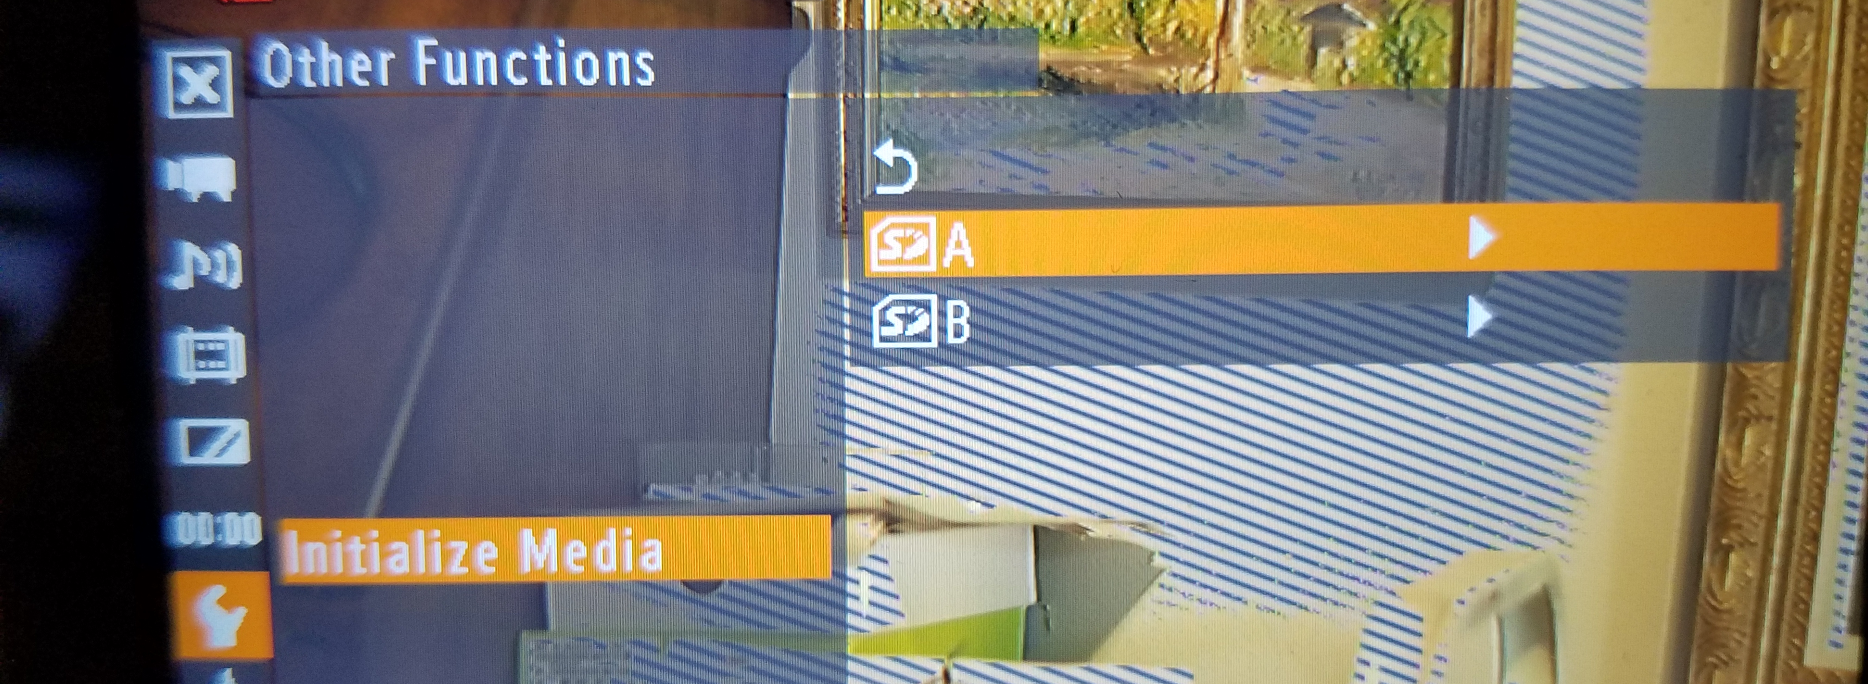
OTHER FUNCTIONS:
FORMAT YOUR CARDS!! HERE IT’S CALLED ‘INITIALIZE’

Slide 41
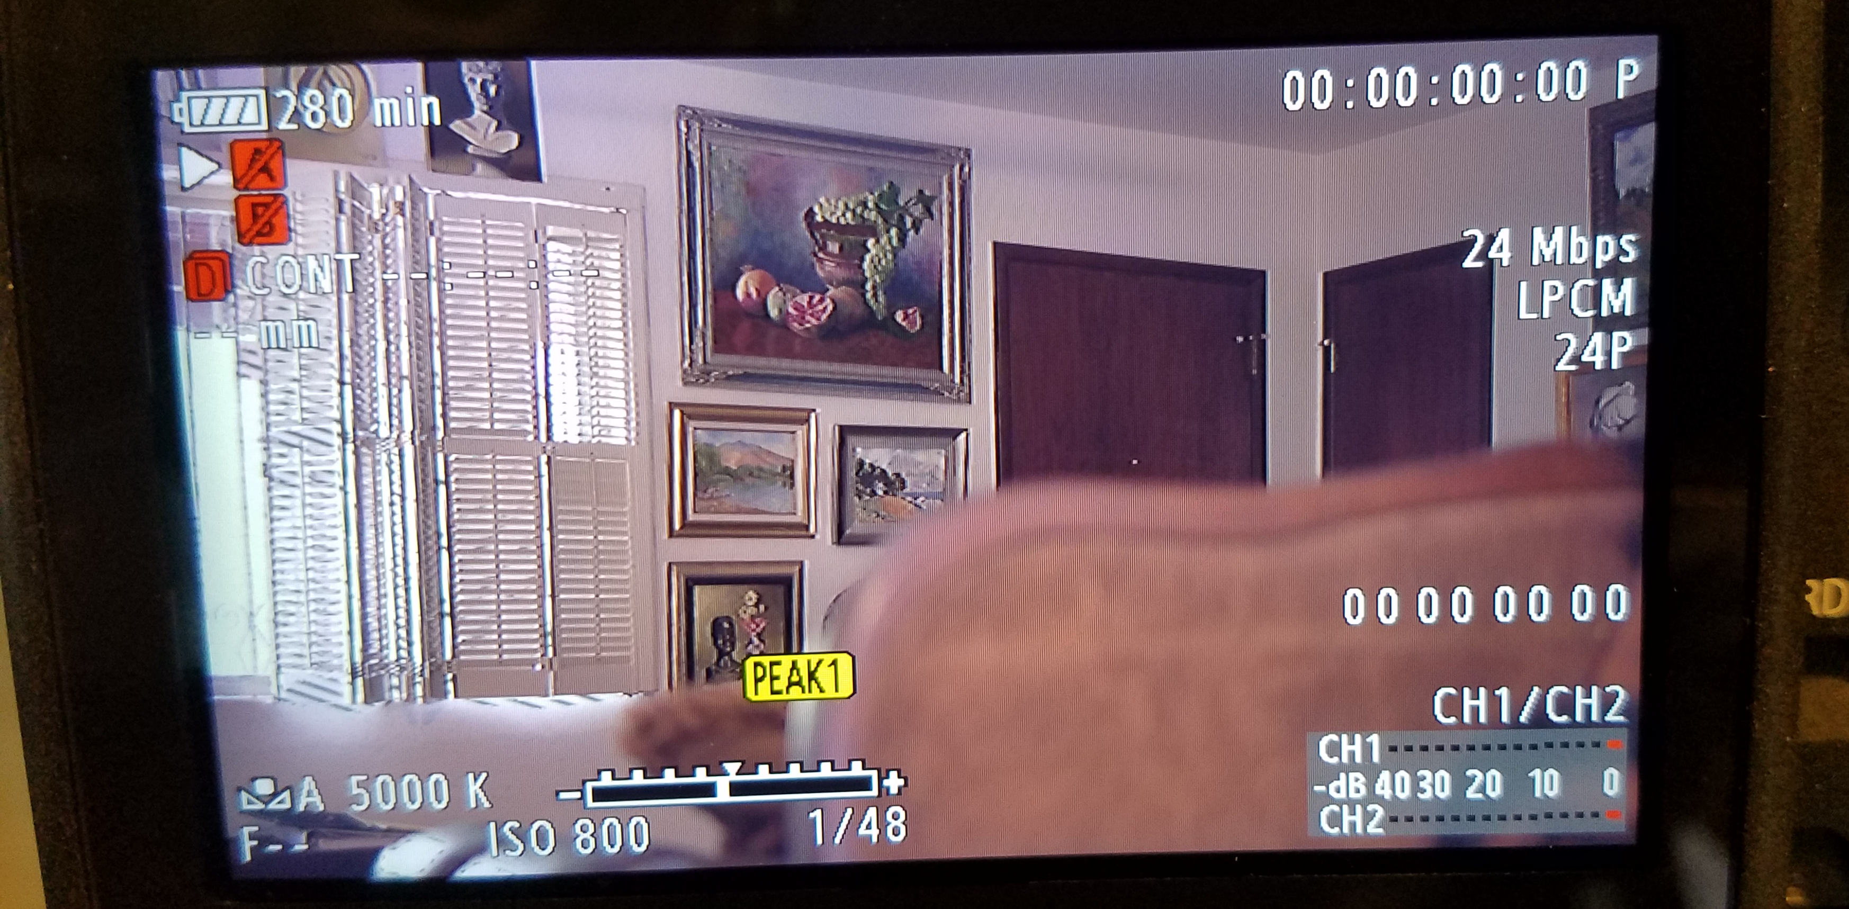
OKAY. NOW LET’S LOOK AT THE LCD SCREEN AND THE SETTINGS:
THESE LOOK VERY GOOD NOW.

Slide 42
OKAY. NOW LET’S LOOK AT THE LCD SCREEN AND THE SETTINGS:
FIXED SHUTTER SPEED & ISO

Slide 43
IF YOU JUST PUSH THE JOY STICK, YOU CAN CHANGE THREE SETTINGS VERY QUICKLY:
ISO
SHUTTER
WHITE BALANCE
THE WHITE BALANCE MODE WILL LIGHT UP ON THE LCD SCREEN. TOGGLE TO THE ISO & IT WILL LIGHT UP. THEN YOU CAN TOGGLE UP OR DOWN TO CHANGE YOUR ISO. SUPER SIMPLE & FAST!

Slide 44
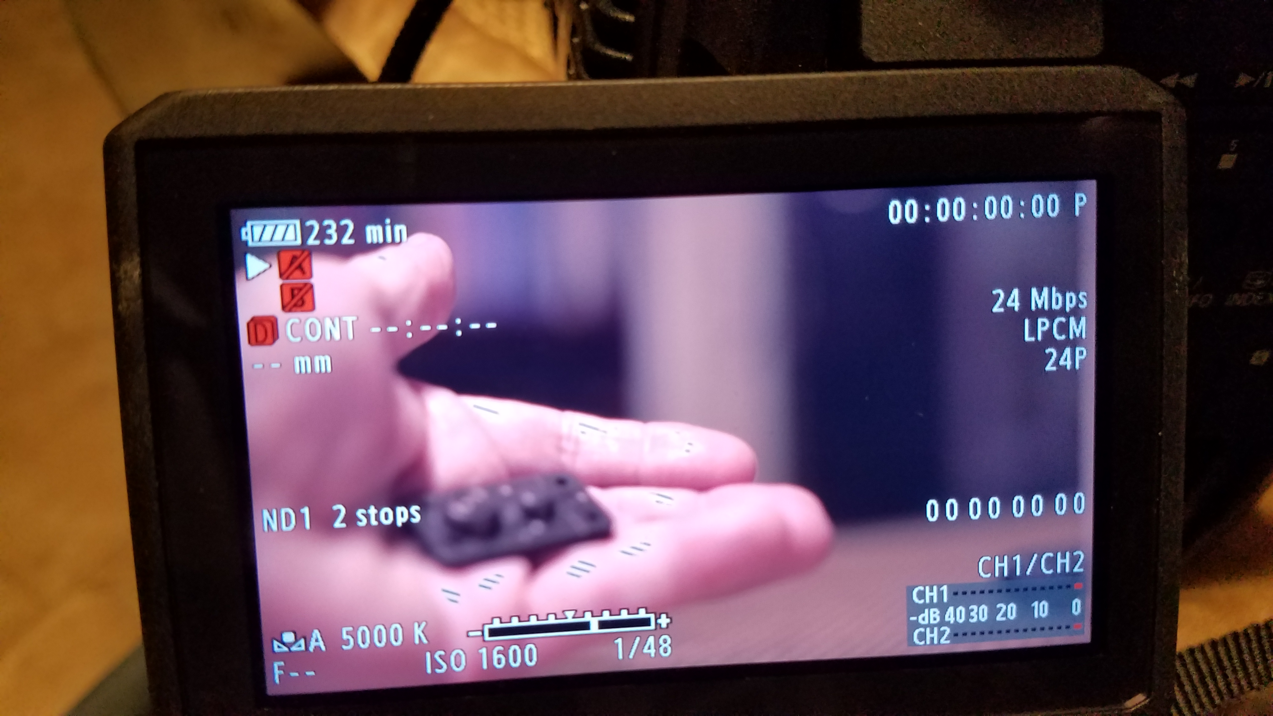
Let’s say you want to check your focus:

Slide 45
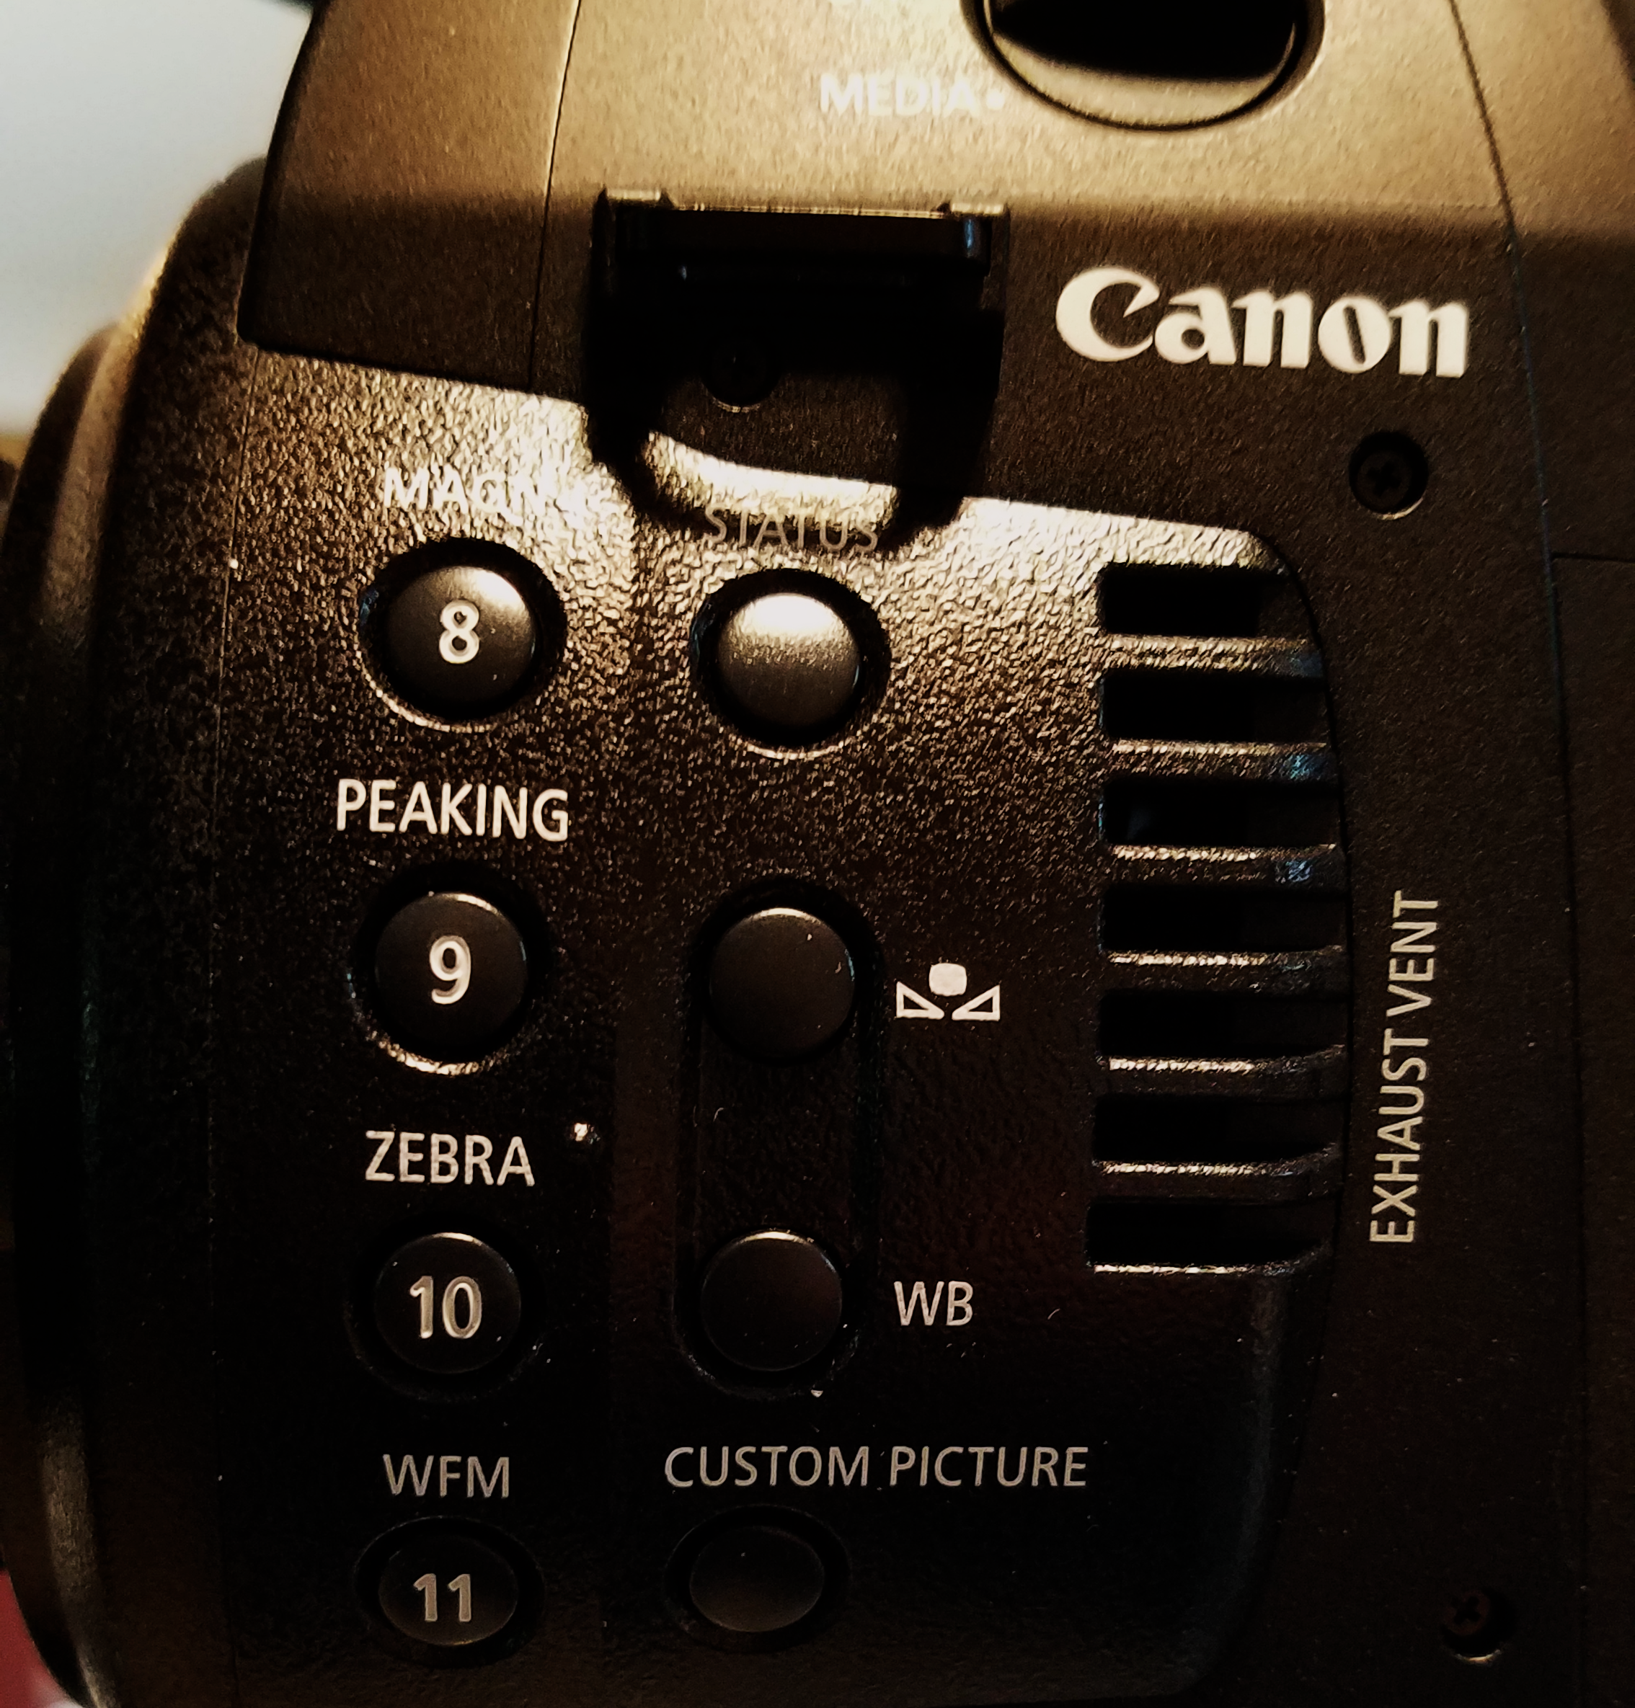
Push the ‘magnify’ button on the side:
This will magnify your shot
So you can focus better.

Slide 46
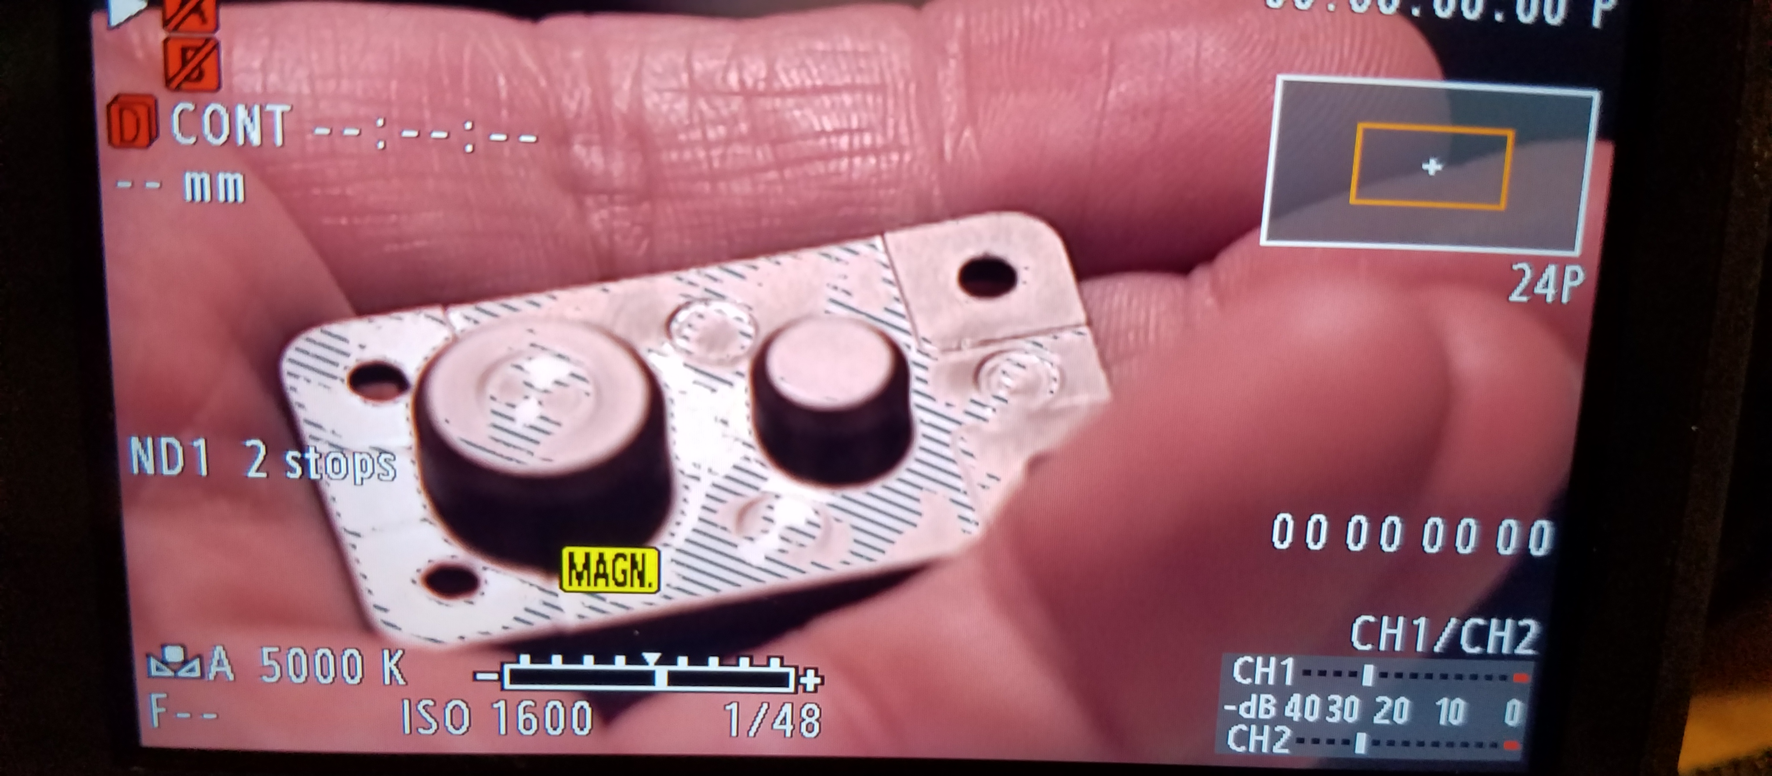
Now the shot is magnified and you know this because you see the little rectangle box in the upper left corner. Also, it says it:

